Slide 1



Introduction to Manfacturing in Business Central
Don Saito, ERP Efficiency Experts, LLC
May 2, 2025

Slide 2



Speakers Wanted

Slide 3




2025 Webinar Committee:
Blaine Pennypacker
Webinar Program
Lewis Rosenberg
Programming Chair
Amanda Mayer
Webinar Program
Shawn Dorward
Programming Chair

Slide 4
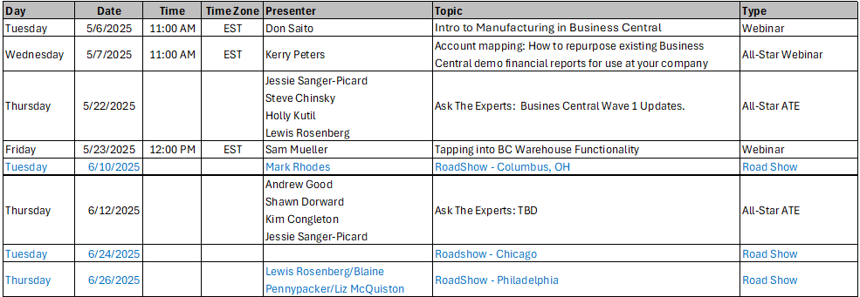
Event Calendar:
Dynamics Communities Events Calendar: https://dynamicscommunities.com/events/month/

Slide 5


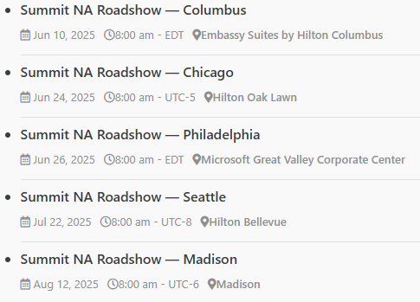
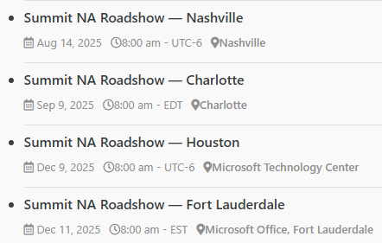
Summit RoadShow
https://dynamicscommunities.com/summit-roadshow/
https://DynamicsCommunities.com
> Events > Summit Roadshow

Slide 6


2023 SPONSOR KIT
You’re invited to the largest independent gathering of the Microsoft Business Applications ecosystem!
www.summitna.com
Notes:
Total Reg 4100 +15%, 1200BC Users (64% attendees), 8 BC Academy Classes
150+ Sessions, 131 Speakers incl MVPs and MS Product Managers

Slide 7
..and now
The Main Event!

Slide 8
Thank you!

Slide 9
Session Agenda
Manufacturing Setup
Production BOMs
Work Centers/Machine Centers
Calendars
Routings
Testing Your Setup
Creating Prod. Orders
Output Journals
Consumption Journals
Production Journal
Finishing Prod. Orders
Analyzing Ledger Entries

Slide 10
Session Objectives
What will you learn today?
1. The terminology of manufacturing.
2. How to setup and use the manufacturing module in Business Central.

Slide 11
Setup Production BOMS
Definition: Production Bill of Materials is a list of items that comprise the finished goods or sub-assembly.
Definition: A sub-assembly is a product that is produced that is used in the production of another sub-assembly or finished good.

Slide 12
Production BOM Tips
Make the Production BOM No. the same as the Item No.
Use Type = Production BOM if you are adding a sub-assembly that you do not wish to count, stock, or treat as a physical item. This is often used in chemicals or food in which a sub-assembly will be consumed in a higher level production process.

Slide 13
Test Production BOM
Enter a Firm Planned/Released production order for the finished good.
Be sure to enter location code!
Check Line, Components
Replan all levels to create Sub-assembly production orders

Slide 14
Create Work Centers/Machine Centers
Definition:
Work Center – an area of the shop floor where a particular operation is carried out.
Machine Center – a machine within assigned to a particular work center.
Work Centers and Machine Centers are optional. Their use gives the ability to add labor costs to the production process and to schedule production orders.
One does not have to use the labor cost aspect of Work Centers if one does not wish to and use work centers for scheduling only.
Calculate the Calendar and check calendar.

Slide 15
Routings
Definition:
Routing – lists all work centers/machine centers involved in the production process. The routing is arranged in the sequence the product flows through

Slide 16
Routing Tips
Use the Item No. as the Routing No.
Assign the Routing to Item.
Personalize screen and add Run Time Unit of Measure and any other desirable fields.

Slide 17
Test Routing
Personalize page and add “Unit Cost per”
Refresh existing production order(s).
Check Line, Routing.
Check Run Times
Check Start Date-Time and Ending Date-Time.
Check Order, Statistics

Slide 18
Prod. Orders
Definitions:
Simulated – for testing purposes only.
Planned – Temporary orders created by the Planning Worksheet. Gets deleted every time the planning worksheet is run.
Firm Planned – Firm order is not touched by planning worksheet unless you accept changes through planning worksheet. You cannot output or consume a firm planned order.
Released – order that has been released to the floor and ready to start consuming and outputting.
Finished – completed order. No further output or consumption may be posted.

Slide 19
Print Reports
Job Card – used as a traveller which moves throughout the production process.
Material Requisition – used as a picking ticket for components
Shortage List – shows components you are out of stock on.

Slide 20
Output/Consumption
Output and consumption may be recorded in any sequence.
You may use:
Production Journal – posts both output and consumption is easy to use but it is easy to inadvertently post everything.
Output Journal – used to post output - alternative to Production Journal
Consumption Journal – used to post consumption – alternative to Production Journal.

Slide 21
Finishing Production Orders
Important to finish them timely.
Do not let them stack up.
Costing is NOT correct until production orders are finished.

Slide 22
Key take-aways
  Setup is critical
  Test your setup by entering a production order and refreshing it.
  Review Output and Consumption carefully before finishing.
  Finishing Production Orders is a MUST. Do not let them stack up.

Slide 23
Thank you for attending!

