Slide 1


Inventory Control - Mastering Inventory Accuracy & Controlling the Costing Layers of Items Inventory
Lynn Glatt & Jen MacIvor
4/3/2025

Slide 2


Speakers Wanted

Slide 3





2025 Webinar Committee:
Blaine Pennypacker
Webinar Program
Lewis Rosenberg
Programming Chair
Amanda Mayer
Webinar Program
Shawn Dorward
Programming Chair

Slide 4
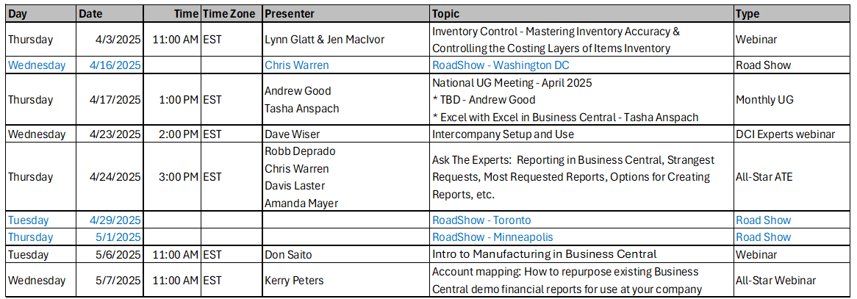
Event Calendar:
Dynamics Communities Events Calendar: https://dynamicscommunities.com/events/month/

Slide 5

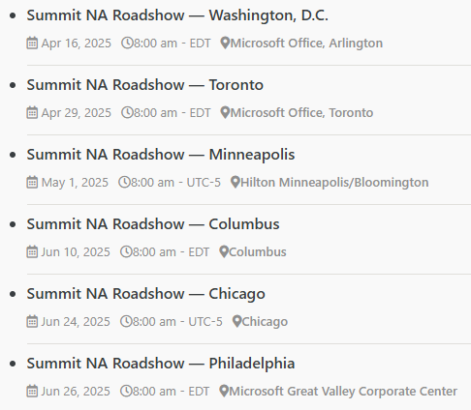
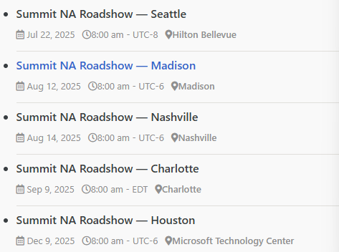
Summit RoadShow
https://dynamicscommunities.com/summit-roadshow/
https://DynamicsCommunities.com
> Events > Summit Roadshow

Slide 6


2023 SPONSOR KIT
You’re invited to the largest independent gathering of the Microsoft Business Applications ecosystem!
www.summitna.com
Notes:
Total Reg 4100 +15%, 1200BC Users (64% attendees), 8 BC Academy Classes
150+ Sessions, 131 Speakers incl MVPs and MS Product Managers

Slide 7
..and now
The Main Event!

Slide 8
Inventory Control - Mastering Inventory Accuracy & Controlling the Costing Layers of Items in Inventory.

Slide 9


Today’s Webinar
Inventory Control - Mastering Inventory Accuracy & Controlling the Costing Layers of Items in Inventory.
Linkedin QR Code
Lynn Glatt

Slide 10



Agenda
Ways to impact decision making and processes with AI
Introduction
Challenges in Inventory Management
Strategies for Optimization
Item Costing Methods
Physical Inventory Methods
Cycle Counting
Inventory Valuation
Q&A Session
Jen MacIvor

Slide 11
Session Objectives
What will you learn today?
Learning Points (LP) Objectives listed below:
LP-1 What makes up Inventory Items and Inventory Accuracy, Cycle Counting, Inventory Item Cost Methods.
LP-2 Determine the appropriate level of WMS for each Location, and the best method to accomplish a Physical Inventory using: Physical Inventory Journals, Whse Physical Inventory Journals, Physical Inventory Orders, Physical Inventory Recordings, Item Reclassification Journals.
LP-3 How to De-Couple your Warehouse Item/Location Cycle Counting program from Item/Inventory Valuation affecting Finance.
LP-4 Adjust Cost – Item Entries: Manual vs. Automated Cost Adjustments & New Inventory Cost Adjustment Tool.

Slide 12

Session Objectives
Microsoft Dynamics 365 Business Central brings the power of AI to small and medium-sized businesses with features that help companies work smarter, adapt faster, and perform better.
Automating repetitive tasks
Improving customer service
Anticipating business challenges
Enhancing decision making
93%
Manufacturing companies added AI initiatives in the past 12 months

Slide 13

LP-1: Items – How to determine the appropriate Cost Method.

Slide 14



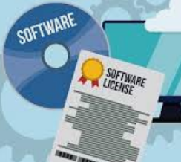
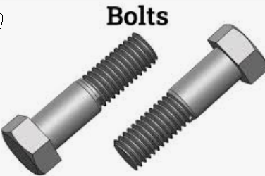


Inventory Items -
What type is for you ?
Item Type:
  Inventory
    Physical Things a company wants to track thru inventory processes
      Bicycle
      Tomato’s
      Water
    What about Non-Physical things ?
      Software Licenses,
      Subscriptions.
  Non-Inventory
    Pan Stock (Bolts)
    Cardboard Slipsheets
  Service
    Labor of Time
    Electric Bill

Slide 15



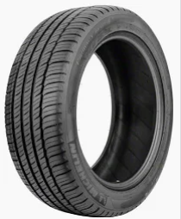

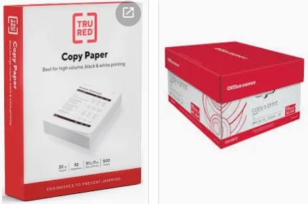
Inventory Costing Method
What is the MOST Popular Costing Method in Food, Beverage?
  FIFO Costing Method
  or FEFO
What is the most used Costing Method in Manufacturing ?
  Standard Costing Method
What is the Costing Method for Non-Inventory?
  Default Costing

Slide 16
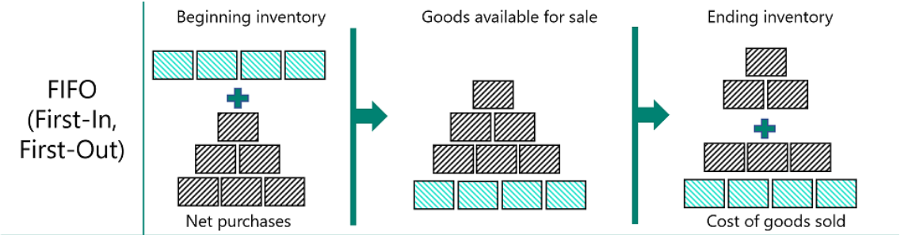
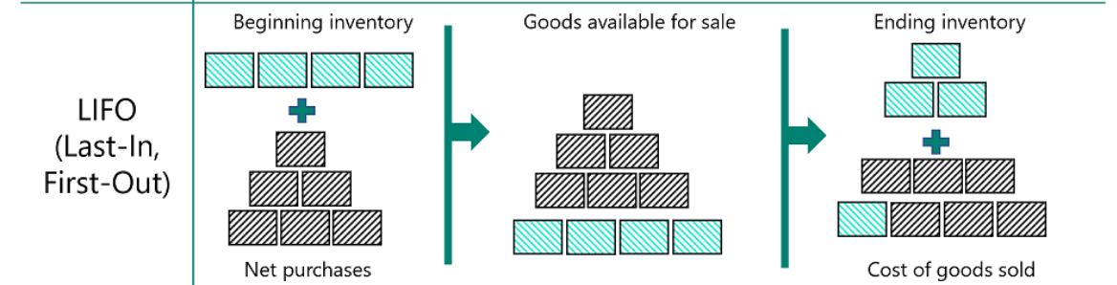
Inventory Costing Method
FIFO Cost
LIFO Cost

Slide 17
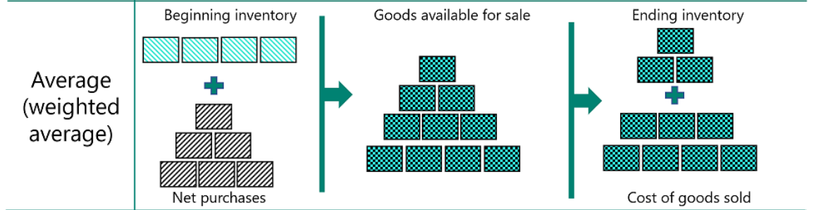
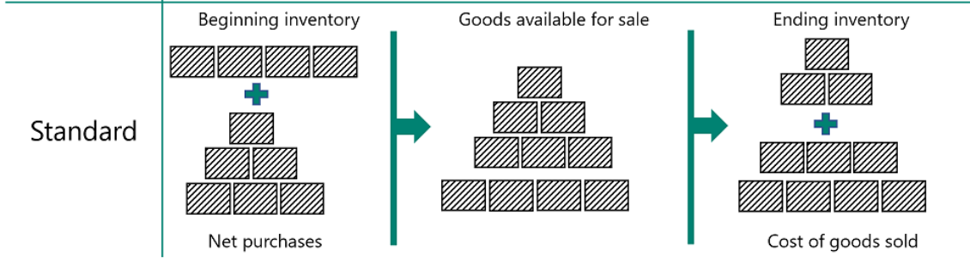
Inventory Costing Method
Average Cost
Standard Cost

Slide 18
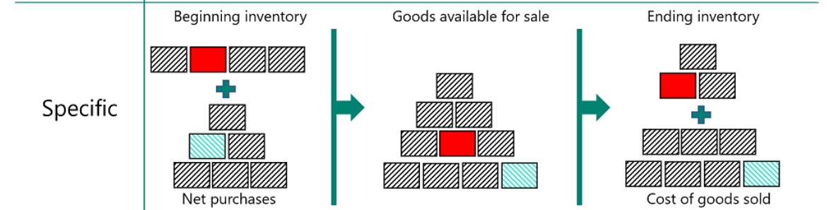
Inventory Costing Method
Specific Cost
Default Cost
  Unit Cost for Non-Inventory
    Update as Req. – Use like Standard Cost
    New as of 2020 Wave 2

Slide 19
Determining the Appropriate
Inventory Costing Method using AI
  Validate company GAAP Accounting methods are leveraging the best costing method available for Inventory, Industry and Company Financials.
Use AI to analyze large datasets to identify patterns trends and compare analysis.

Slide 20


Determining the Appropriate
Inventory Costing Method using AI
Strategic reasons to change accounting methods:
Financial Reporting and Tax Implications | FIFO: Higher net income during rising prices → Higher taxes LIFO: Reduces taxable income during inflation → Lower taxes
Economic Conditions | Inflation or deflation can prompt method changes to reflect current cost
Business Strategy | Align costing method with strategy (e.g., FIFO for stronger financial position)
Regulatory Compliance | Changes in accounting standards or tax regulations may require method changes
Operational Changes | Mergers, acquisitions, or shifts in product lines may necessitate different methods
Improved Accuracy | Switch methods for more accurate inventory valuation
Competitive Advantage | Optimize inventory management and cost control for competitive edge
Python Analysis
Excel Copilot
Data Manipulation
Pandas: This library is essential for data manipulation and analysis. It provides data structures like DataFrames to handle and manipulate data efficiently.
https://techcommunity.microsoft.com/blog/excelblog/introducing-copilot-support-for-python-in-excel-advanced-data-analysis-using-nat/3928120

Slide 21


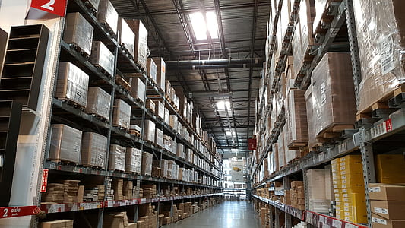
LP-2a: WMS – How to determine the appropriate level of complexity for a given Location.
Location
Location / Shelve
Location / Bin
Location / Zone / Bin
Location / Zone / Bin / Bin Content

Slide 22

Business Central Warehouse Configuration Options
Exploring basic & advanced options for warehouse optimization
Notes:
In this presentation, we will explore the various warehouse configuration options available in Business Central. We will discuss the default configuration, advanced configuration options, and additional customization options. By the end of this presentation, you will have a comprehensive understanding of how to optimize your warehouse for maximum efficiency.

Slide 23
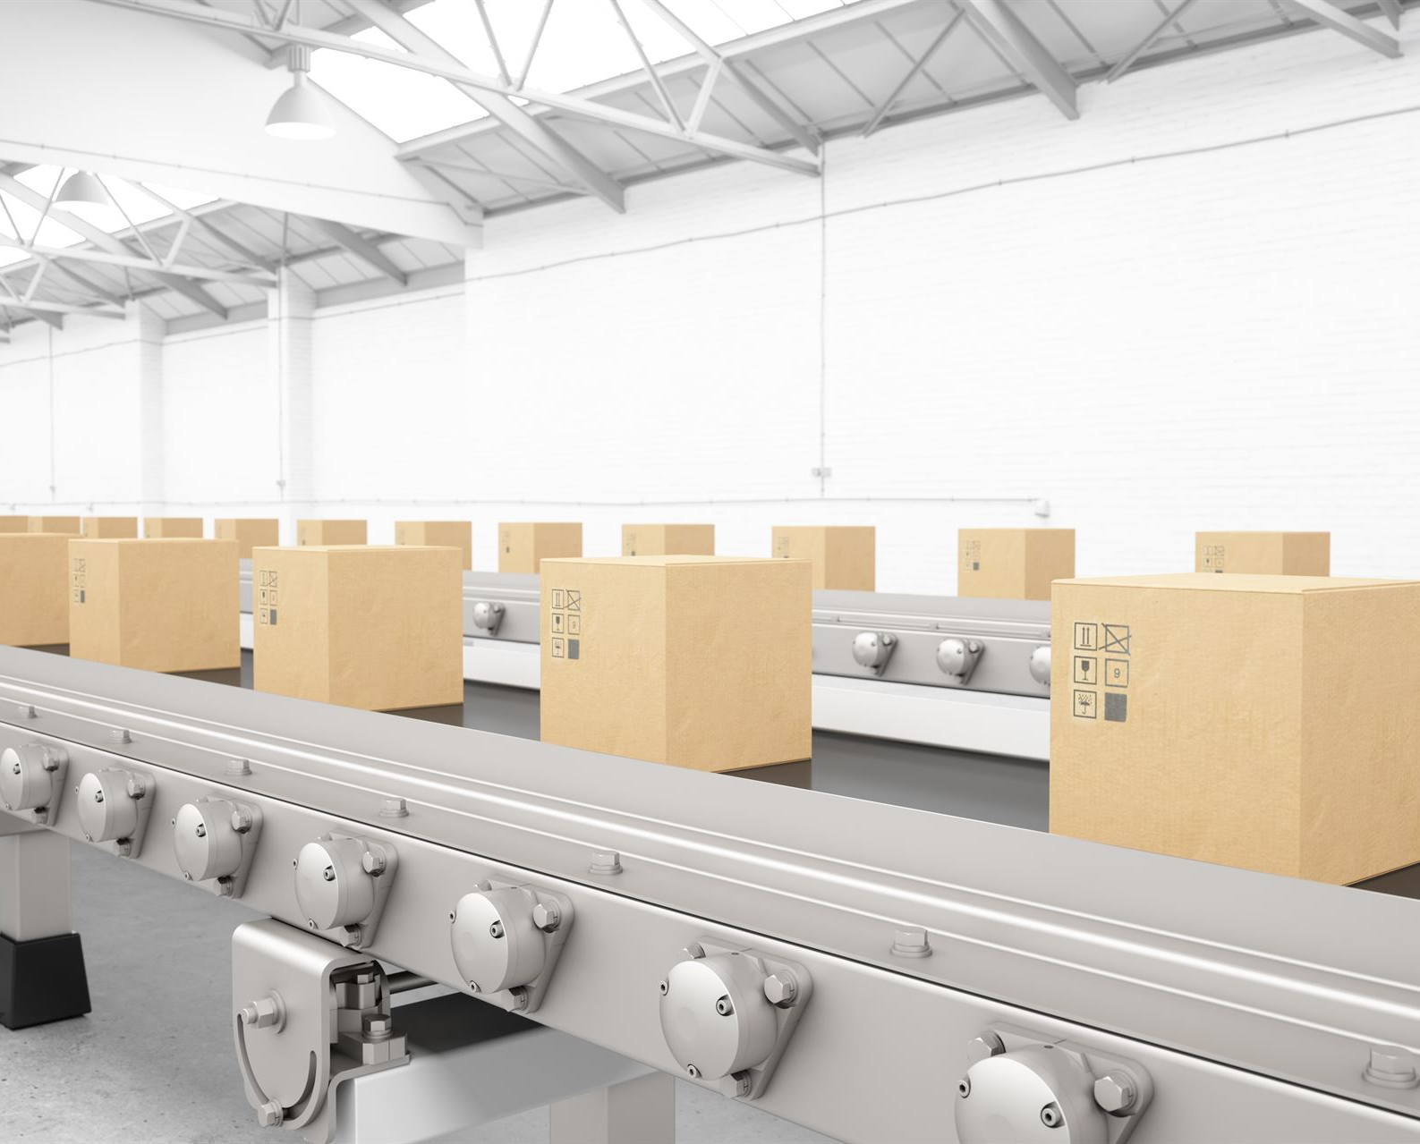
Default Warehouse Configuration
Default Configuration
  The default warehouse configuration in Business Central provides a solid foundation for warehouse management. It includes features such as warehouse locations, item tracking codes, and warehouse processes, which can be customized to meet specific business needs.
Defining Locations
  Defining warehouse locations is an essential step in setting up warehouse management. It involves creating bins and assigning them to specific areas within the warehouse for efficient inventory management.
Item Tracking Codes
  Creating item tracking codes is an important part of warehouse management. It involves defining the criteria for tracking items, such as lot numbers, serial numbers, and expiration dates, to ensure accurate inventory tracking and management.
Notes:
The default warehouse configuration in Business Central provides a solid foundation for warehouse management. We will explore how to set up warehouse management, including defining locations, creating item tracking codes, and setting up warehouse processes.

Slide 24

Warehouse Management Setup
Warehouse Management Features
  To use Business Central's warehouse management features, you need to configure your warehouse management setup, including defining locations, creating item tracking codes, and setting up warehouse processes.
Defining Locations
  Defining locations is an essential part of setting up a warehouse management system, as it allows you to track inventory movements and manage stock levels more effectively.
Creating Item Tracking Codes
  Creating item tracking codes allows you to track inventory movements and monitor stock levels at a more granular level. This is particularly important for businesses that deal with high-value or perishable items.
Setting up Warehouse Processes
  Setting up warehouse processes is crucial for efficient warehouse management and inventory tracking. This includes defining picking and putaway strategies, setting up bin and container management, and configuring wave and batch processing.
Notes:
In order to use Business Central's warehouse management features, you need to configure your warehouse management setup. We will explore how to set up warehouse management, including defining locations, creating item tracking codes, and setting up warehouse processes.

Slide 25

Advanced Warehouse Configuration
Bin Setup and Content
  Business Central offers options for advanced bin setup and management of bin content, allowing businesses to optimize their warehouse operations.
Work Templates
  Work templates enable businesses to automate and streamline warehouse operations, reducing the time and effort required to manage large volumes of inventory.
Other Advanced Features
  Business Central offers other advanced warehouse configuration features, such as workflow automation and mobile device integration, to help businesses optimize their warehouse operations.
Notes:
For businesses with more complex warehouse needs, Business Central offers advanced warehouse configuration options. We will explore bin setup and content, work templates, and other advanced features.

Slide 26

Bin Setup and Content
Bin Types
  Defining bin types is the first step in bin setup and content. Different bin types can be used to store different types of items, such as bulk items, small items, or fragile items.
Bin Content
  Creating bin content involves specifying the items that will be stored in each bin, and the quantity of each item. This ensures efficient inventory management and prevents overstocking or stockouts.
Assigning Bins to Locations
  Assigning bins to locations involves identifying the physical location of each bin in the warehouse. This ensures that items can be easily located and retrieved when needed.
Notes:
Bin setup and content is a critical aspect of warehouse management. We will explore how to set up bins and bin content in Business Central, including defining bin types, creating bin content, and assigning bins to locations.

Slide 27

Additional Warehouse Configuration Options
Cross-docking
  Cross-docking is an inventory management strategy that involves unloading materials from inbound vehicles and loading them directly onto outbound vehicles, without storing them in the warehouse. It reduces handling costs and improves delivery times.
Directed Put-away and Pick
  Directed put-a-way and pick is a warehouse management strategy that uses pre-configured rules to direct the movement of goods in the warehouse. It ensures that goods are stored and picked in the most efficient way, reducing handling and travel time.
Inventory Pick and Put-away Strategies
  Inventory pick and put-away strategies are warehouse management strategies that aim to optimize the use of warehouse space and minimize travel time. They involve grouping similar products together and storing them in designated areas to facilitate picking and put-away operations.
Notes:
In addition to the default and advanced warehouse configuration options, Business Central offers additional customization options. We will explore cross-docking, directed putaway and pick, and inventory pick and put-away strategies.

Slide 28

Cross-Docking
Cross-docking in Warehouse Management
  Cross-docking is a technique used in warehouse management to minimize handling and increase efficiency, aimed at reducing storage time and handling costs
Configuring Cross-docking Locations
  Setting up cross-docking locations is a critical step in implementing cross-docking in Business Central. This requires creating receiving and shipping Locations, defining their settings and assigning them to transfer orders.
Defining Cross-docking Templates
  Defining cross-docking templates is a key step in the process of configuring cross-docking in Business Central. This involves setting up rules for handling and processing goods during cross-docking, based on factors such as product type, quantity, and delivery schedules.
Assigning Cross-docking Locations to Shipments
  Assigning cross-docking locations to shipments is the final step in configuring cross-docking in Business Central. This involves creating transfer orders, selecting the appropriate cross-docking location, and processing the shipment.
Notes:
Cross-docking is a technique used in warehouse management to minimize handling and increase efficiency. We will explore how to set up cross-docking in Business Central, including configuring cross-docking locations, defining cross-docking templates, and assigning cross-docking locations to shipments.

Slide 29
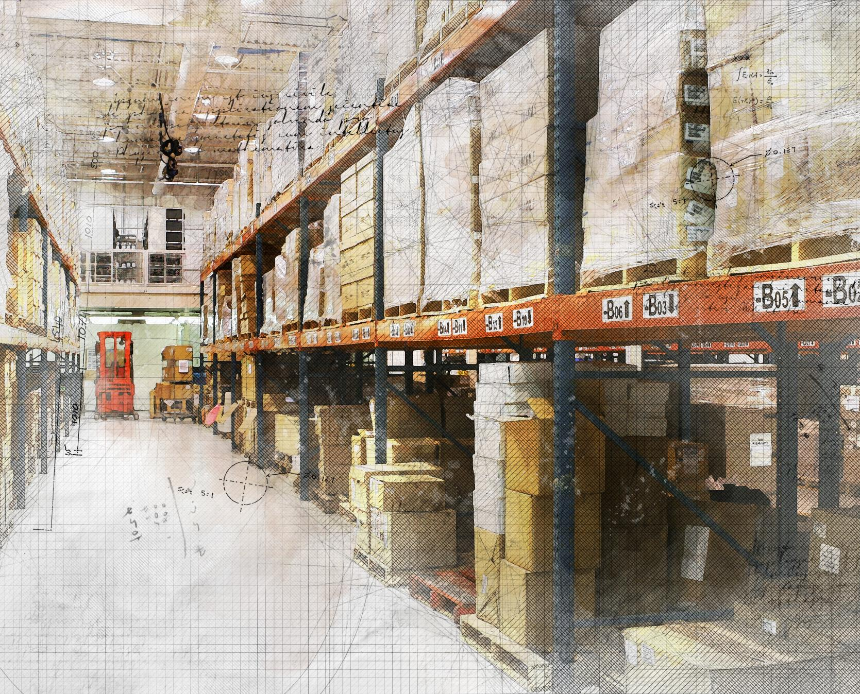
Directed Putaway and Pick
Feature of Business Central
  Directed put-away and pick is a feature in Business Central that helps minimize handling and increase efficiency.
Defining Put-away Templates
  Defining put-away templates in Business Central is necessary to direct the location of incoming items to their correct destination in the warehouse, as defined by rules that you set up
Creating Pick Instructions
  Creating pick instructions in Business Central is necessary to direct the location of outgoing items to their correct destination in the warehouse, as defined by rules that you set up
Configuring Directed Put-away and Pick Rules
  Configuring directed put-away and pick rules in Business Central is necessary to set up rules for how items are put away and picked in the warehouse.
Notes:
Directed putaway and pick is a feature in Business Central that helps minimize handling and increase efficiency. We will explore how to set up directed putaway and pick, including defining put-away templates, creating pick instructions, and configuring directed put-away and pick rules.

Slide 30
Inventory Pick and Put-Away Strategies
Wave Picking
  Wave picking is an inventory pick and put-away strategy that groups similar orders together into waves. This saves time and increases efficiency by reducing the number of trips necessary to pick and put away inventory.
Batch Picking
  Batch picking is an inventory pick and put-away strategy that allows warehouse workers to pick multiple orders at once. This saves time and increases efficiency by reducing the number of trips necessary to pick and put away inventory.
Zone Picking
  Zone picking is an inventory pick and put-away strategy that divides the warehouse into zones. Each picker is assigned to a specific zone, and they only pick and put away inventory within that zone. This saves time and increases efficiency by reducing the amount of travel time necessary to pick and put away inventory.
Notes:
Business Central offers various inventory pick and put-away strategies that can be customized to meet your specific warehouse needs. We will explore the different strategies available, including wave picking, batch picking, and zone picking.

Slide 31
LP-2b: Determine the best method to accomplish a Inventory Levels and how to preform Physical Inventory:
Inventory Forecast Levels (Using AI)
Physical Inventory Journals
Whse Physical Inventory Journals
Physical Inventory Orders &
Physical Inventory Recordings
V. Item Reclassification Journals.
Notes:
Jen to Discuss AI Inventory Forecast and Stockkeeping Levels using AI Type : (Methods) Then discuss crafting a Azure Machine Learning Model to customize the Algorithm.
.

Slide 32

LP-2b: Determine the best method to accomplish a Inventory Levels and how to preform Physical Inventory:
Using AI for Inventory Forecasting
Predict Future Sales: | The extension uses Azure AI to analyze historical sales data and predict future sales. On the Items page, select an item to view its forecast in the Item Forecast pane.
Avoid Stockouts | Based on the forecast, the extension can suggest replenishment requests to vendors. For example, if the forecast predicts a shortage of a specific item, it will recommend placing an order to restock.
Optimize Inventory Levels | Use the forecast data to balance inventory levels, ensuring you have enough stock to meet customer demand without overstocking. This helps reduce costs associated with excess inventory while maintaining high customer satisfaction.
Predictive Web Services | Dynamics 365 BC provides access to several predictive web services that calculate predictions on demand without storing data. You can also create and use your own predictive web service for more customized forecasting.
Integration with Other Tools | The AI capabilities can be integrated with tools like Netstock’s Predictor Inventory Advisor, which offers advanced predictive analytics for smarter inventory decisions.
Enable the Sales and Inventory Forecast Extension:
Notes:
Jen to Discuss AI Inventory Forecast and Stockkeeping Levels using AI Type : (Methods) Then discuss crafting a Azure Machine Learning Model to customize the Algorithm.
.

Slide 33
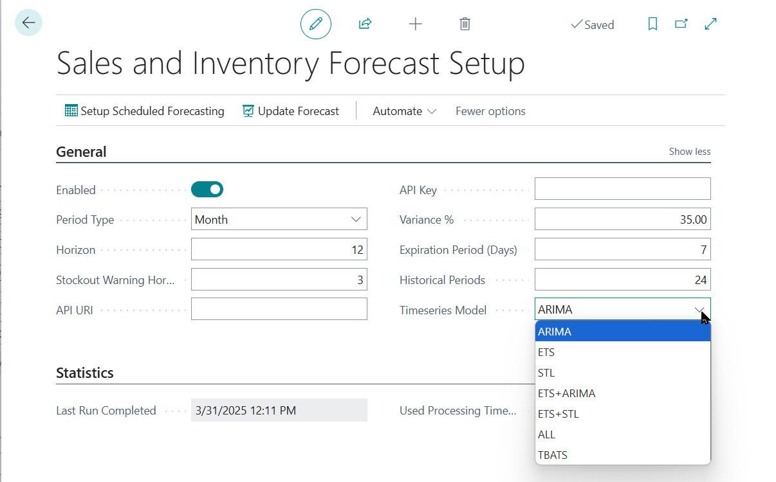
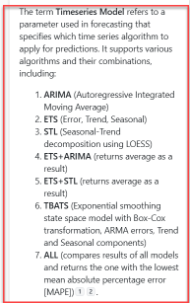
LP-2b: Inventory Forecast Levels Setup:
Inventory Forecast Levels (Using AI)
Notes:
Jen to Discuss AI Inventory Forecast and Stockkeeping Levels using AI Type : (Methods)

Slide 34
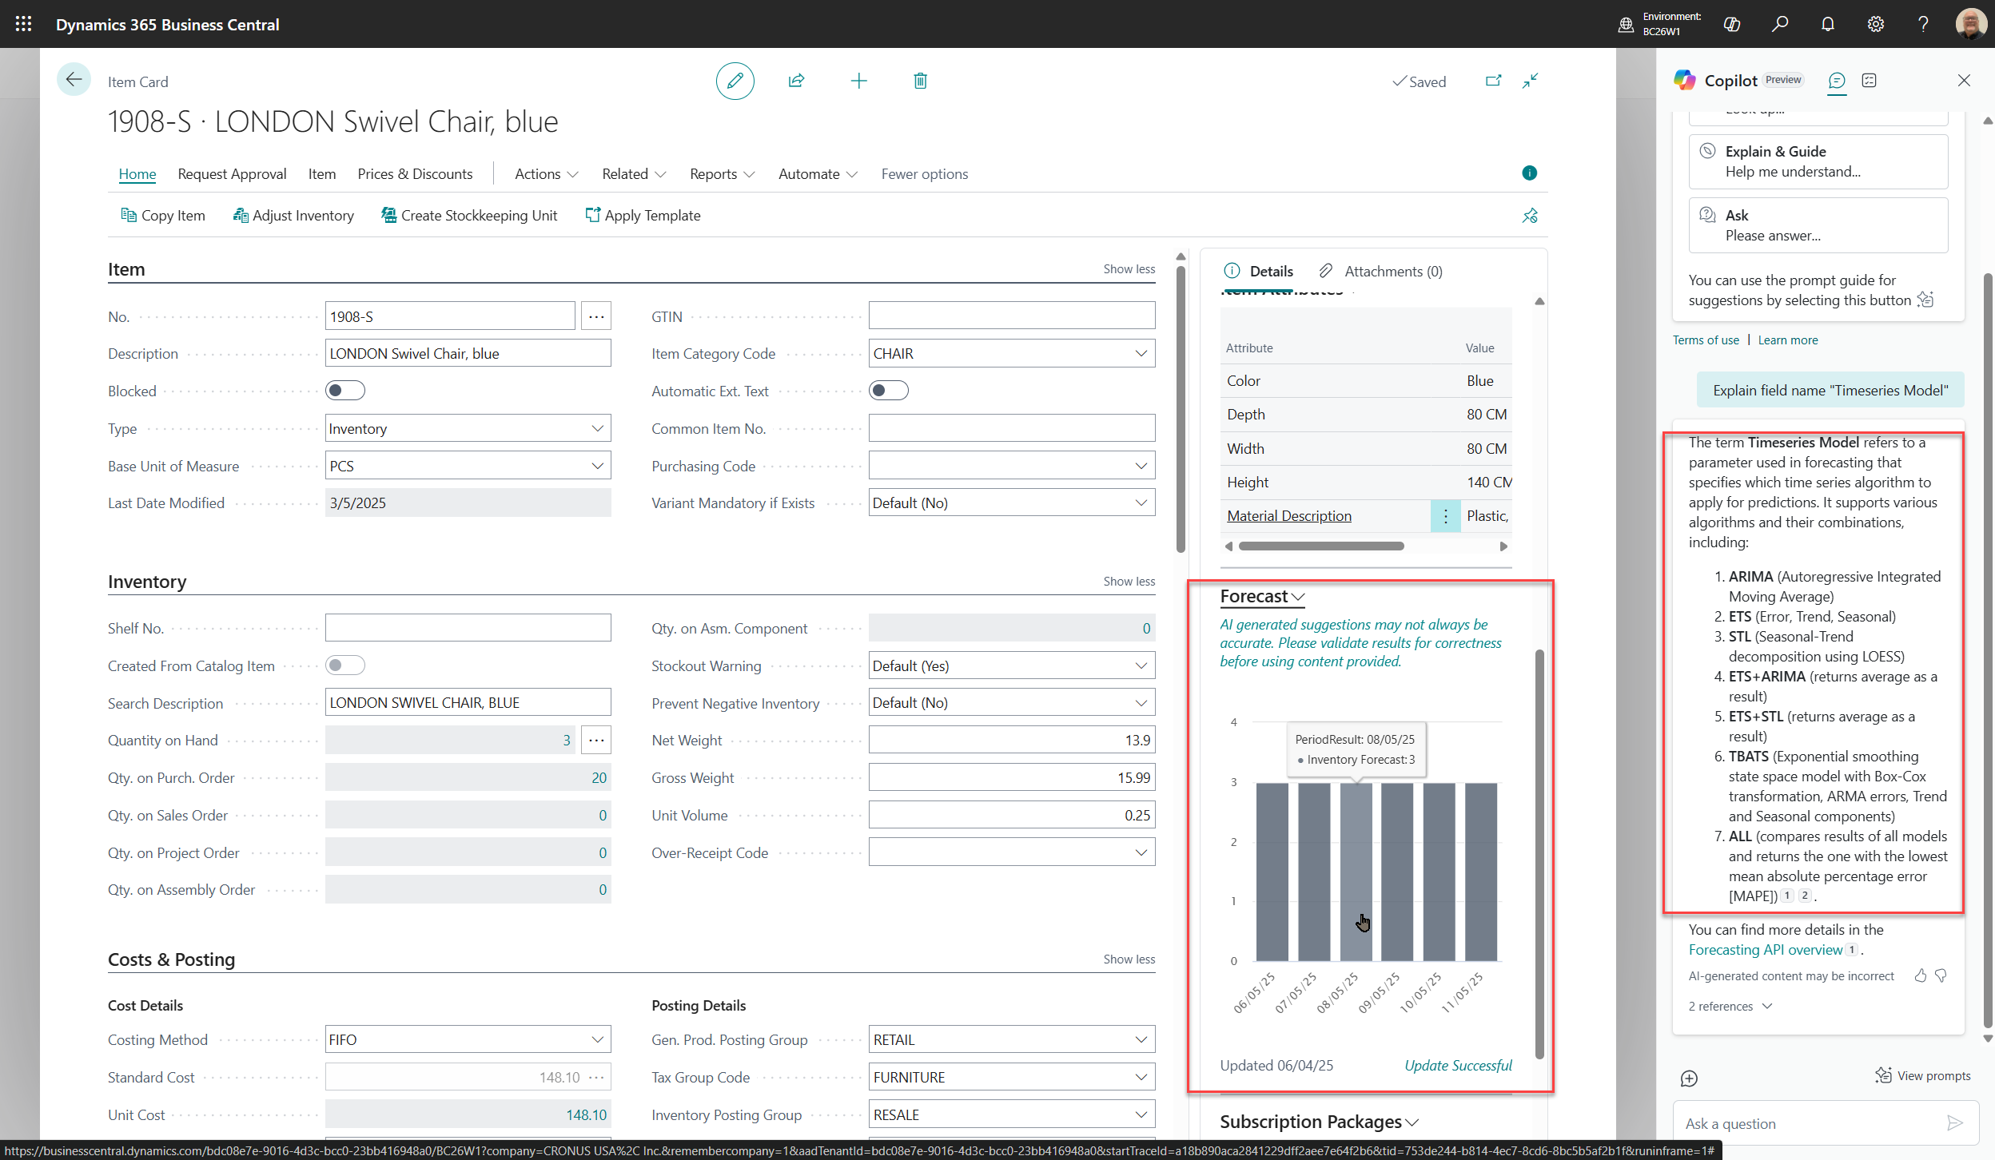
Inventory Forecasting using AI
Timeseries Model:
ARIMA
ETS
ETS+ARIMA
ETS+STL
TBATS
ALL
Notes:
Jen to Discuss AI Inventory Forecast and Stockkeeping Levels using AI Type : (Methods)

Slide 35
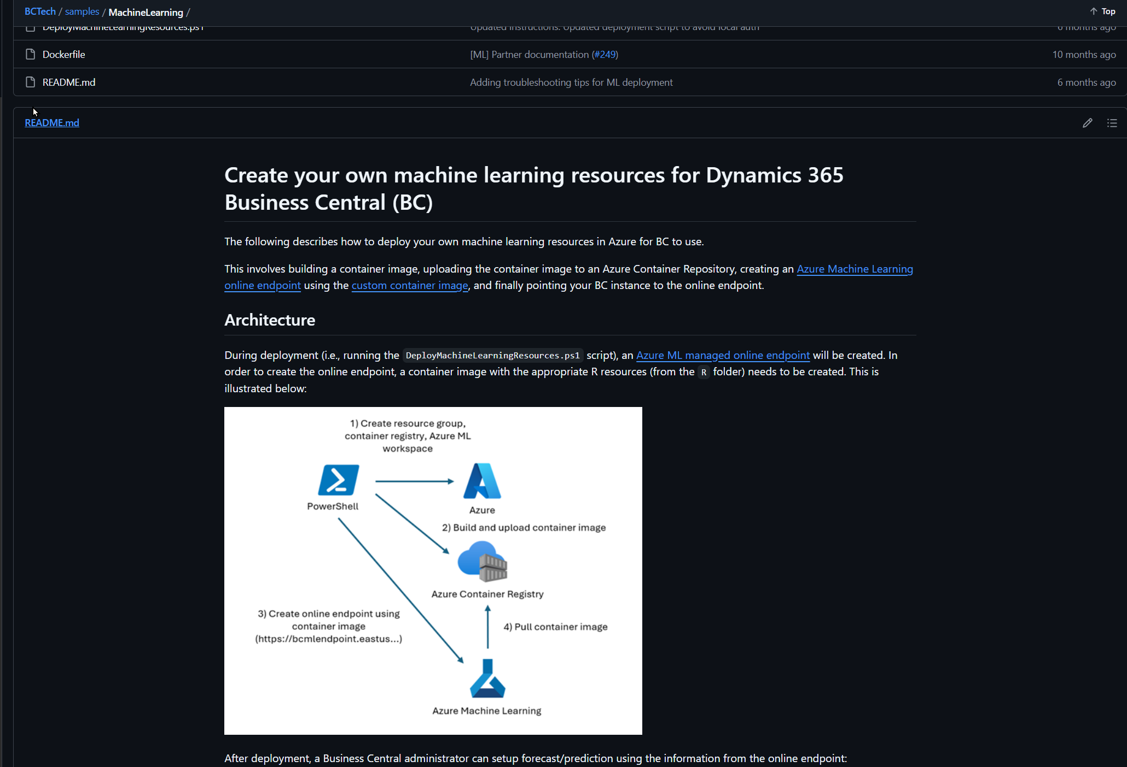
Craft your own Machine Learning
Timeseries Model:
ARIMA
ETS
ETS+ARIMA
ETS+STL
TBATS
ALL
Notes:
Jen – To Discuss Inventory Forecasting AI Capabilities

Slide 36
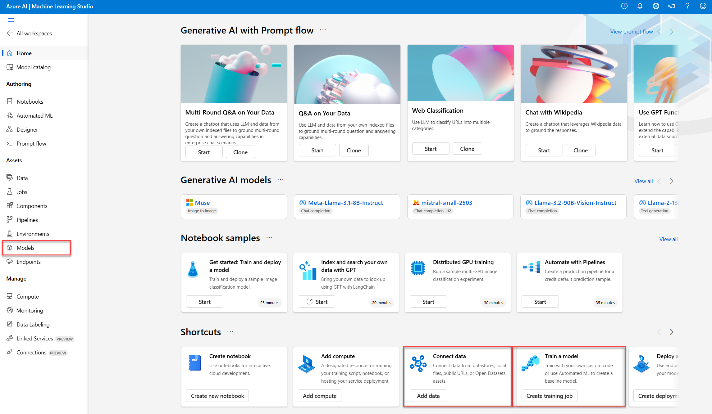
Azure: Machine Learning Models
Azure: Models
Connect Data
Train Model
Notes:
Jen – To Discuss Inventory Forecasting AI Capabilities

Slide 37

Inventory Management using Business Central
Efficiently manage inventory with
LP2b.I - Physical Inventory Journal
Notes:
In this presentation, we will explore how Business Central helps businesses manage their inventory using the Physical Inventory Journal. We will cover how to set up Physical Inventory Journals, post them, conduct physical inventory counting, and reconcile inventory differences.

Slide 38

Physical Inventory Journal
Counting Physical inventory, for a Warehouse w/ only a location.
- Directed put away NOT enabled
- Directed pick NOT enabled.
Notes:
Business Central is an all-in-one business management solution that helps businesses streamline their operations. Efficient inventory management is key to the success of any business. In this section, we will discuss the importance of inventory management and how Business Central helps businesses achieve it.

Slide 39
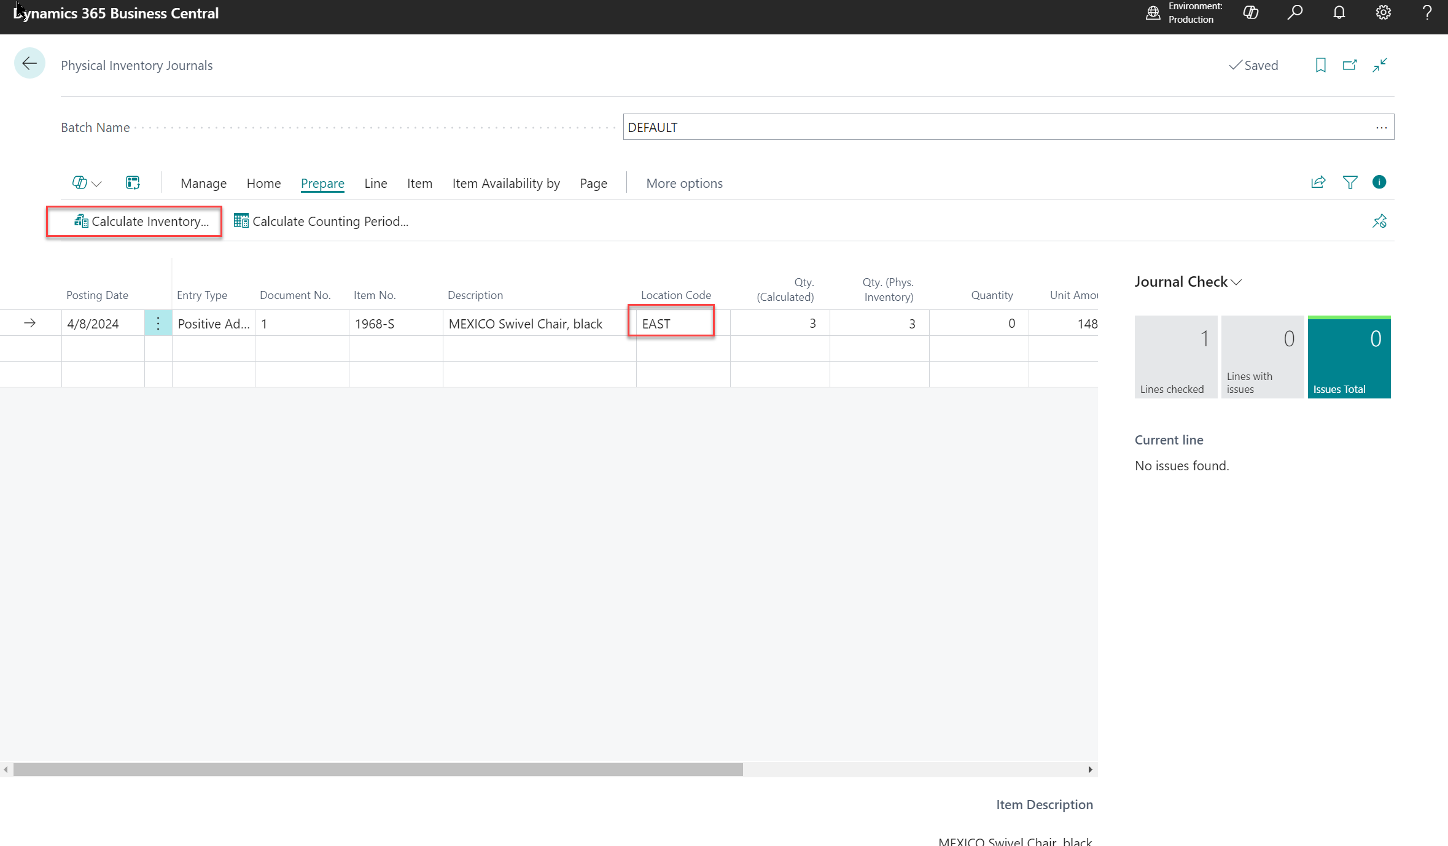
Setting up Physical Inventory Journals
  Setting up Physical Inventory Journals in Business Central is an important step in keeping track of your inventory levels. This process involves creating the journal, assigning it to a location, and defining the counting method and frequency.
Notes:
The Physical Inventory Journal is a tool in Business Central that helps businesses keep track of their inventory levels. In this section, we will cover how to set up Physical Inventory Journals and configure them according to your business needs.

Slide 40
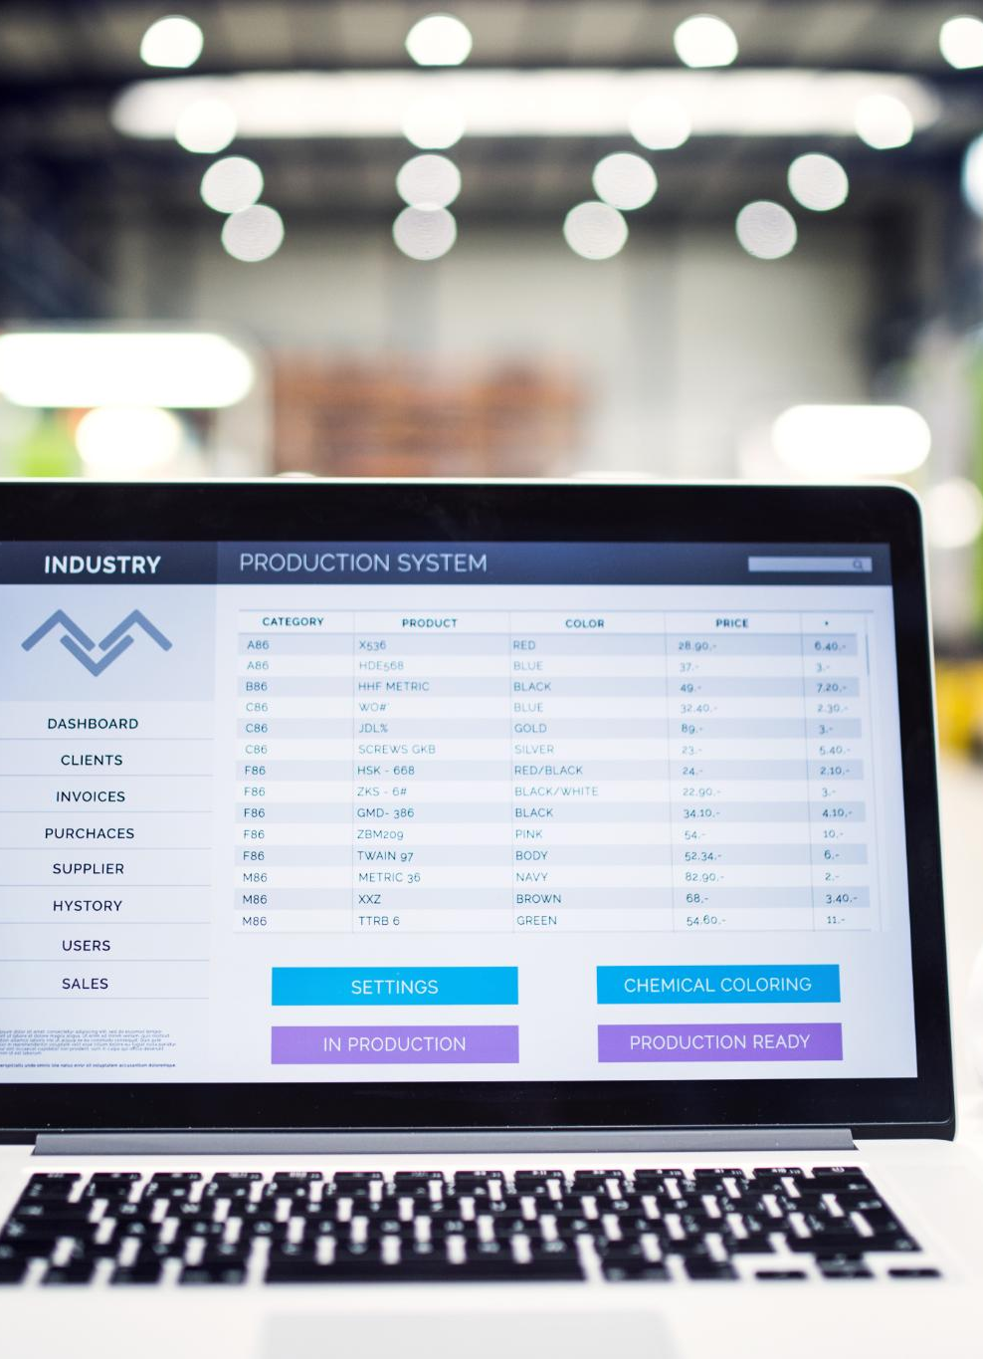
Posting Physical Inventory Journals
Posting Process
  Posting Physical Inventory Journals is a simple process that updates inventory levels in Business Central. It involves selecting the journal, verifying the entries, and posting the journal.
Inventory Level Update
  Posting Physical Inventory Journals updates inventory levels in Business Central, ensuring that the system accurately reflects the actual inventory quantity.
Adjustments to Inventory Transactions
  In Business Central, it is possible to make adjustments to inventory transactions. This allows for corrections to be made to inventory levels as needed.
Notes:
Once the Physical Inventory Journals are set up, it is time to post them. In this section, we will cover the posting process and how it updates inventory levels in Business Central. We will also discuss how to make adjustments to inventory transactions.

Slide 41
Inventory Management using Business Central
Efficiently manage inventory with
LP2b.II – Warehouse Physical Inventory Journal
LP3 - De-Couple your Warehouse Item/Location Cycle Counting program from Item/Inventory Valuation affecting Finance.
Notes:
In this presentation, we will explore how Business Central helps businesses manage their inventory using the Physical Inventory Journal. We will cover how to set up Physical Inventory Journals, post them, conduct physical inventory counting, and reconcile inventory differences.

Slide 42

Warehouse Physical Inventory Journal
Notes:
In this presentation, we will explore the concept of the Business Central Warehouse Physical Inventory Journal and how it can help you manage your inventory more effectively.

Slide 43
Warehouse Physical Inventory Journal
Warehouse Physical inventory, for a Location with following:
Location, Bin
Location, Zone, Bin
- Directed put away Enabled,
- Directed pick Enabled.
Notes:
Business Central is an all-in-one business management solution that helps businesses streamline their operations. Efficient inventory management is key to the success of any business. In this section, we will discuss the importance of inventory management and how Business Central helps businesses achieve it.

Slide 44
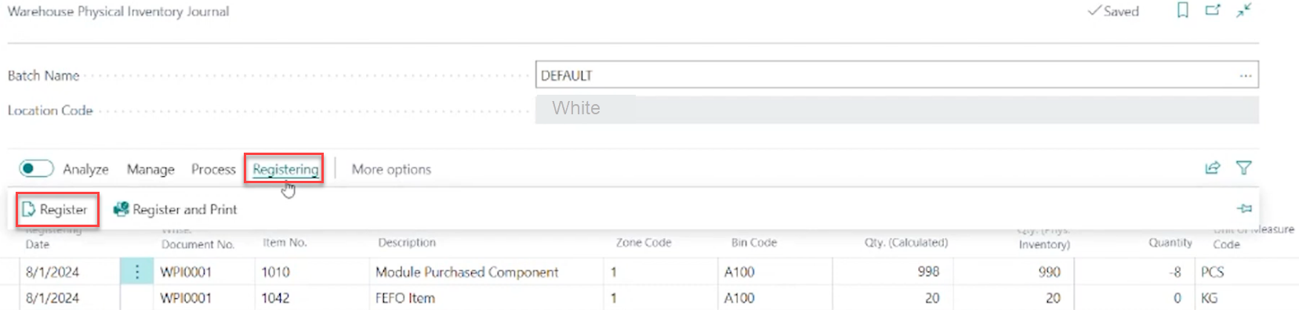
Warehouse Physical Inventory Journal
Register – Warehouse Entries
Then GOTO Item Journal
NOTE: Warehouse Inventory is now Separated from Financial Inventory Value

Slide 45
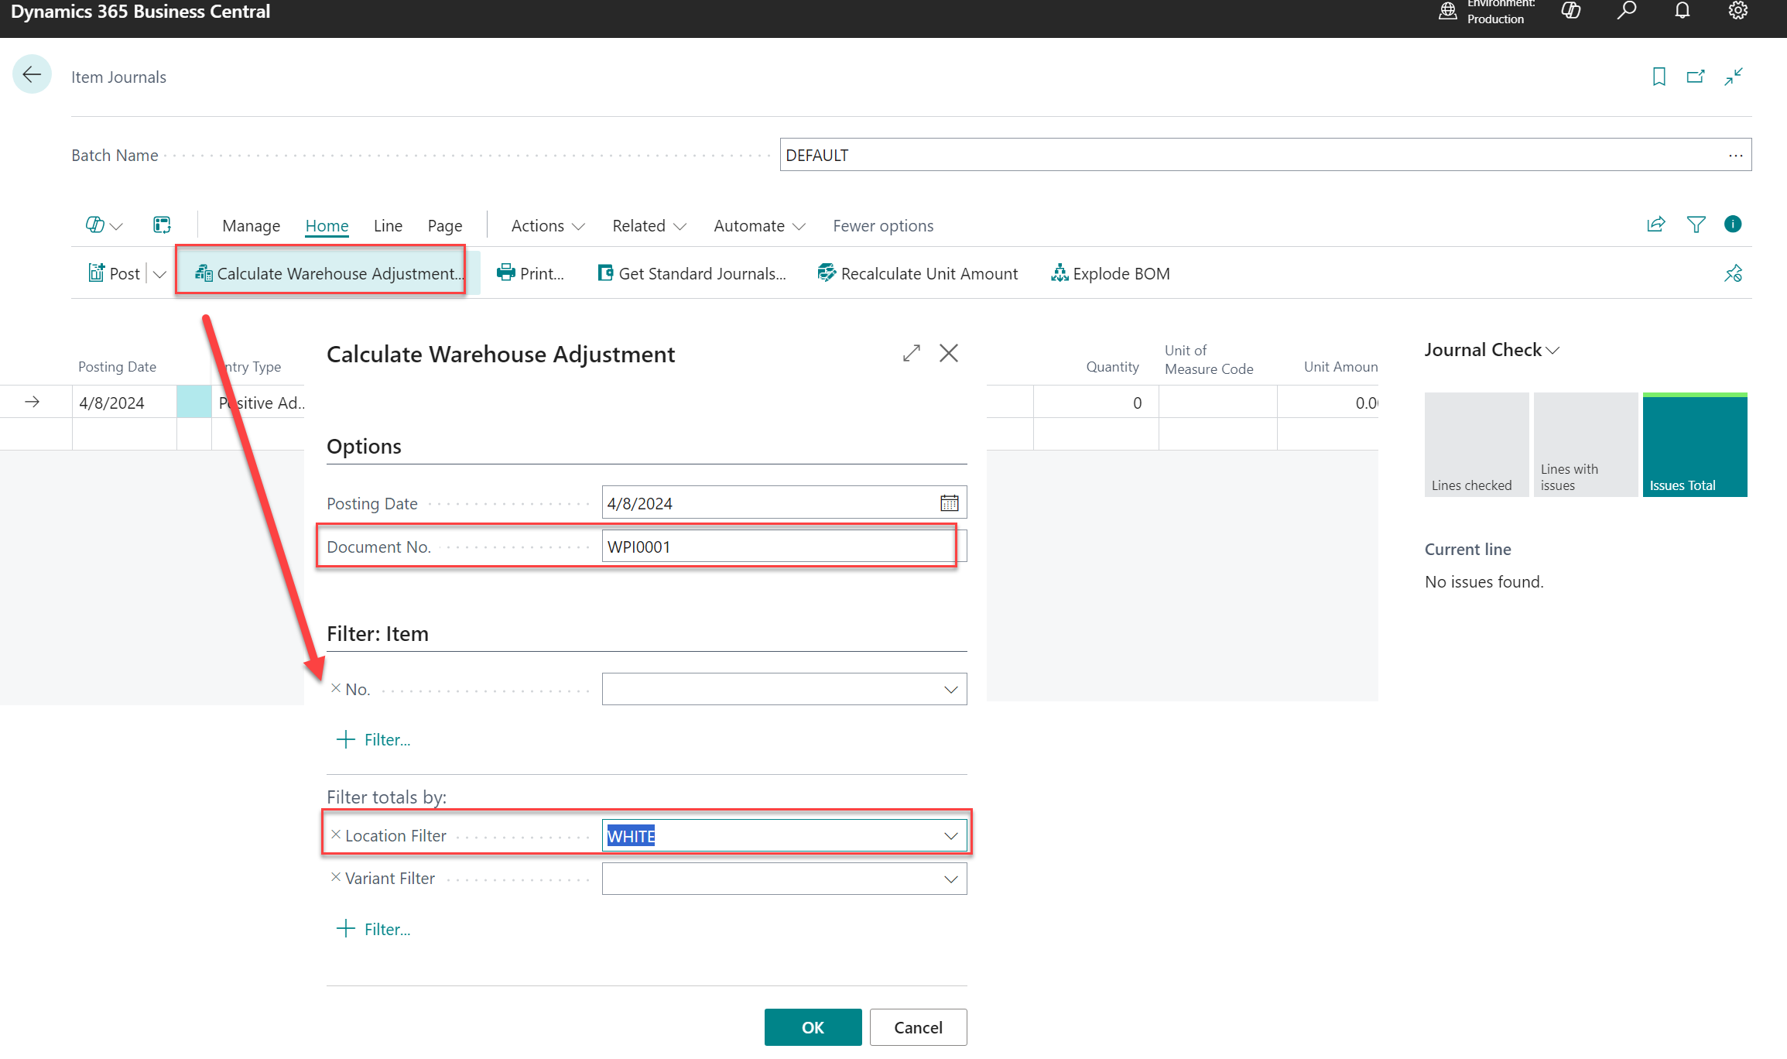
Warehouse Physical Inventory Journal
Second Part – Item Journal
Item Journal
Select: Calculate Warehouse Adjustment
Then Post Item Journal
NOTE: Warehouse Inventory is now Separated from Financial Inventory Value

Slide 46
Inventory Management using Business Central
Efficiently manage inventory with
LP2b.III – Physical Inventory Orders &
Physical Inventory Recordings
Notes:
In this presentation, we will explore how Business Central helps businesses manage their inventory using the Physical Inventory Journal. We will cover how to set up Physical Inventory Journals, post them, conduct physical inventory counting, and reconcile inventory differences.

Slide 47

Presentation Overview
Physical Inventory Order Overview
  Physical Inventory Order is the process of ordering physical inventory for your business. We will be discussing the overview of Physical Inventory Order in this presentation.
Physical Inventory Recording Overview
  Physical Inventory Recording is the process of recording physical inventory in your business. We will be discussing the overview of Physical Inventory Recording in this presentation.
Creating Physical Inventory Order
  We will go over how to create a Physical Inventory Order, which includes the steps involved in ordering physical inventory for your business.
Recording Physical Inventory
  We will go over how to record the physical inventory that you have ordered, which includes the steps involved in recording physical inventory in your business.
Notes:
We will start with an overview of Physical Inventory Order and Physical Inventory Recording. Then, we will dive into the details of both topics. We will go over how to create a Physical Inventory Order, and then how to record the physical inventory that you have ordered.

Slide 48

Physical Inventory Order
  Physical Inventory Order is a tool used to record inventory in a warehouse. It allows you to keep track of your stock levels to ensure that you have enough inventory on hand. Physical Inventory Order can be conducted manually or electronically and requires a systematic approach.
Notes:
Physical Inventory Order is used to record the inventory that you have in your warehouse. It is important to keep track of this inventory so that you can make sure you have enough stock on hand. We will start by going over the basics of Physical Inventory Order.

Slide 49
Introduction to
Physical Inventory Order
What is a Physical Inventory Order?
  A Physical Inventory Order is a document used to record the inventory in your warehouse. It helps you keep track of your stock levels and ensure that you have enough products to meet customer demand.
Why is Physical Inventory Important?
  Physical Inventory is important because it helps you maintain accurate stock levels. This prevents stockouts, which can lead to lost sales and unhappy customers. It also helps you identify slow-moving products and make informed decisions about your purchasing and inventory management.
  NOTE: The Physical Inventory Order came from Germany and was incorporated into NAV/BC in 2018
Notes:
Physical Inventory Order is used to record the inventory that you have in your warehouse. It is important to keep track of this inventory so that you can make sure you have enough stock on hand.

Slide 50
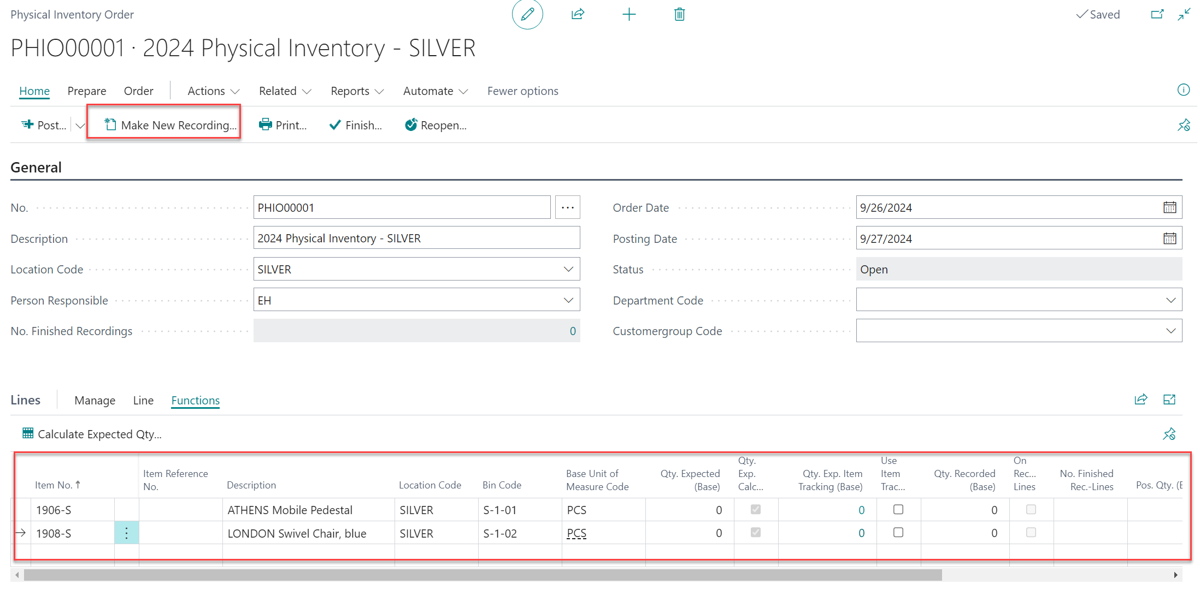
Creating a Physical Inventory Order
  To create a Physical Inventory Order, you can use the Physical Inventory Worksheet. This worksheet will help you keep track of your inventory and make the process more efficient.
Notes:
Creating a Physical Inventory Order is a simple process. You can use the Physical Inventory Worksheet to create a physical inventory order. We will go over the steps to create a Physical Inventory Order.

Slide 51

Physical Inventory Recording
What is Physical Inventory Recording?
  Physical Inventory Recording is the process of counting and recording the physical inventory that you have in your warehouse. It is important to keep track of this inventory so that you can make sure you have enough stock on hand and avoid stockouts.
Why is Physical Inventory Recording Important?
  Physical Inventory Recording is important because it helps you keep track of your inventory, which in turn helps you make informed decisions about stock levels, ordering, and reordering. It also helps you identify any discrepancies between your physical inventory and your records.
Notes:
Physical Inventory Recording is the process of recording the physical inventory that you have in your warehouse. It is important to keep track of this inventory so that you can make sure you have enough stock on hand. We will go over the basics of Physical Inventory Recording.

Slide 52
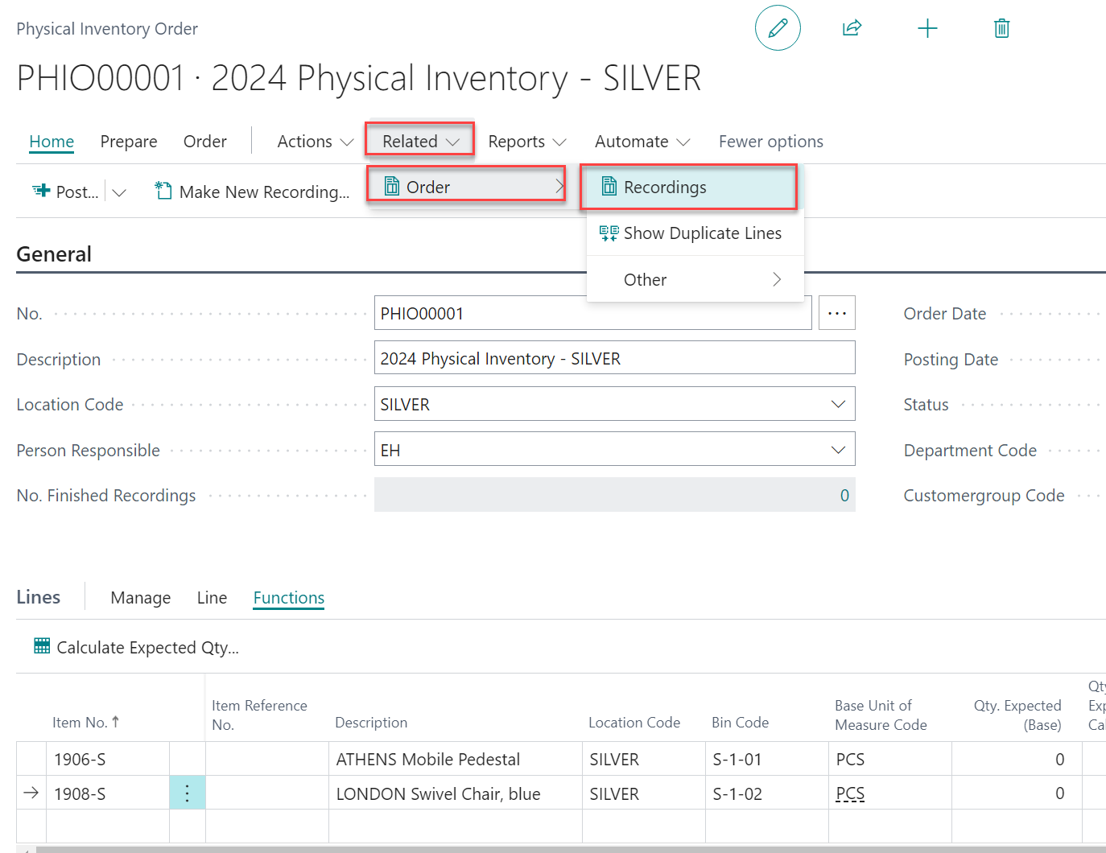
Creating a Physical Inventory Recording
  From the Physical Inventory Order, you can Make New Recording.
  Then Select Related, Other and Recordings
Notes:
Creating a Physical Inventory Order is a simple process. You can use the Physical Inventory Worksheet to create a physical inventory order. We will go over the steps to create a Physical Inventory Order.

Slide 53
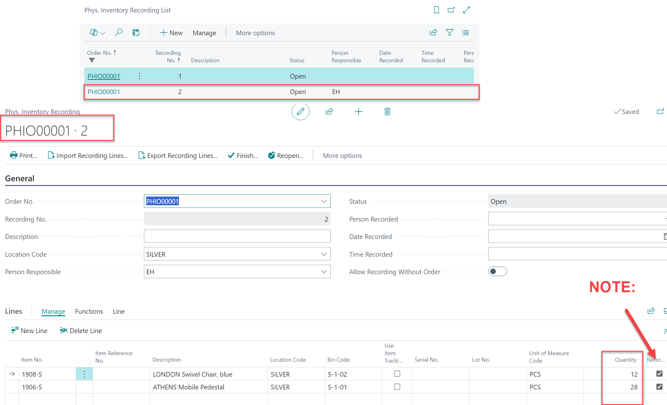
Creating a Physical Inventory Recording
  From the Physical Inventory Recording List, Select an OPEN Recording.
  Then Select Related, Other and Recordings
Notes:
Creating a Physical Inventory Order is a simple process. You can use the Physical Inventory Worksheet to create a physical inventory order. We will go over the steps to create a Physical Inventory Order.

Slide 54
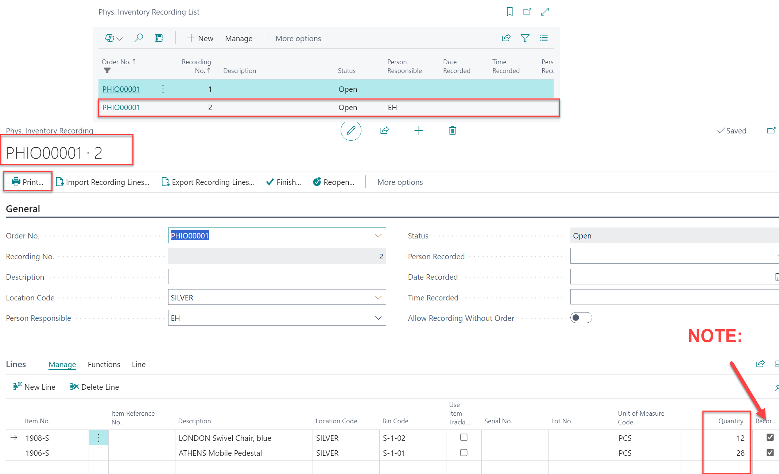
Creating a Physical Inventory Recording
  From the Physical Inventory Recording List, Select an OPEN Recording.
  Then Select Print and Print for each Warehouse Employee.
Notes:
Creating a Physical Inventory Order is a simple process. You can use the Physical Inventory Worksheet to create a physical inventory order. We will go over the steps to create a Physical Inventory Order.

Slide 55
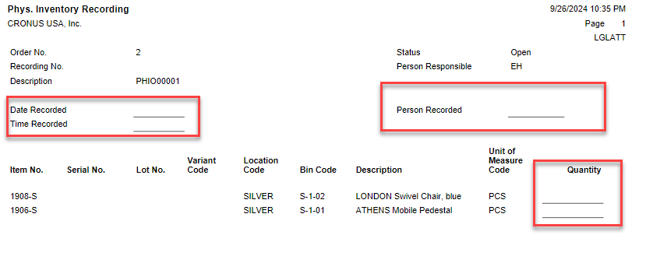
Creating a Physical Inventory Recording
  Warehouse Employee Records Item and Bin Inventory Quantity.
  Then Return to the Warehouse office to get entered in to Physical Inventory Recording.
Notes:
Creating a Physical Inventory Order is a simple process. You can use the Physical Inventory Worksheet to create a physical inventory order. We will go over the steps to create a Physical Inventory Order.

Slide 56
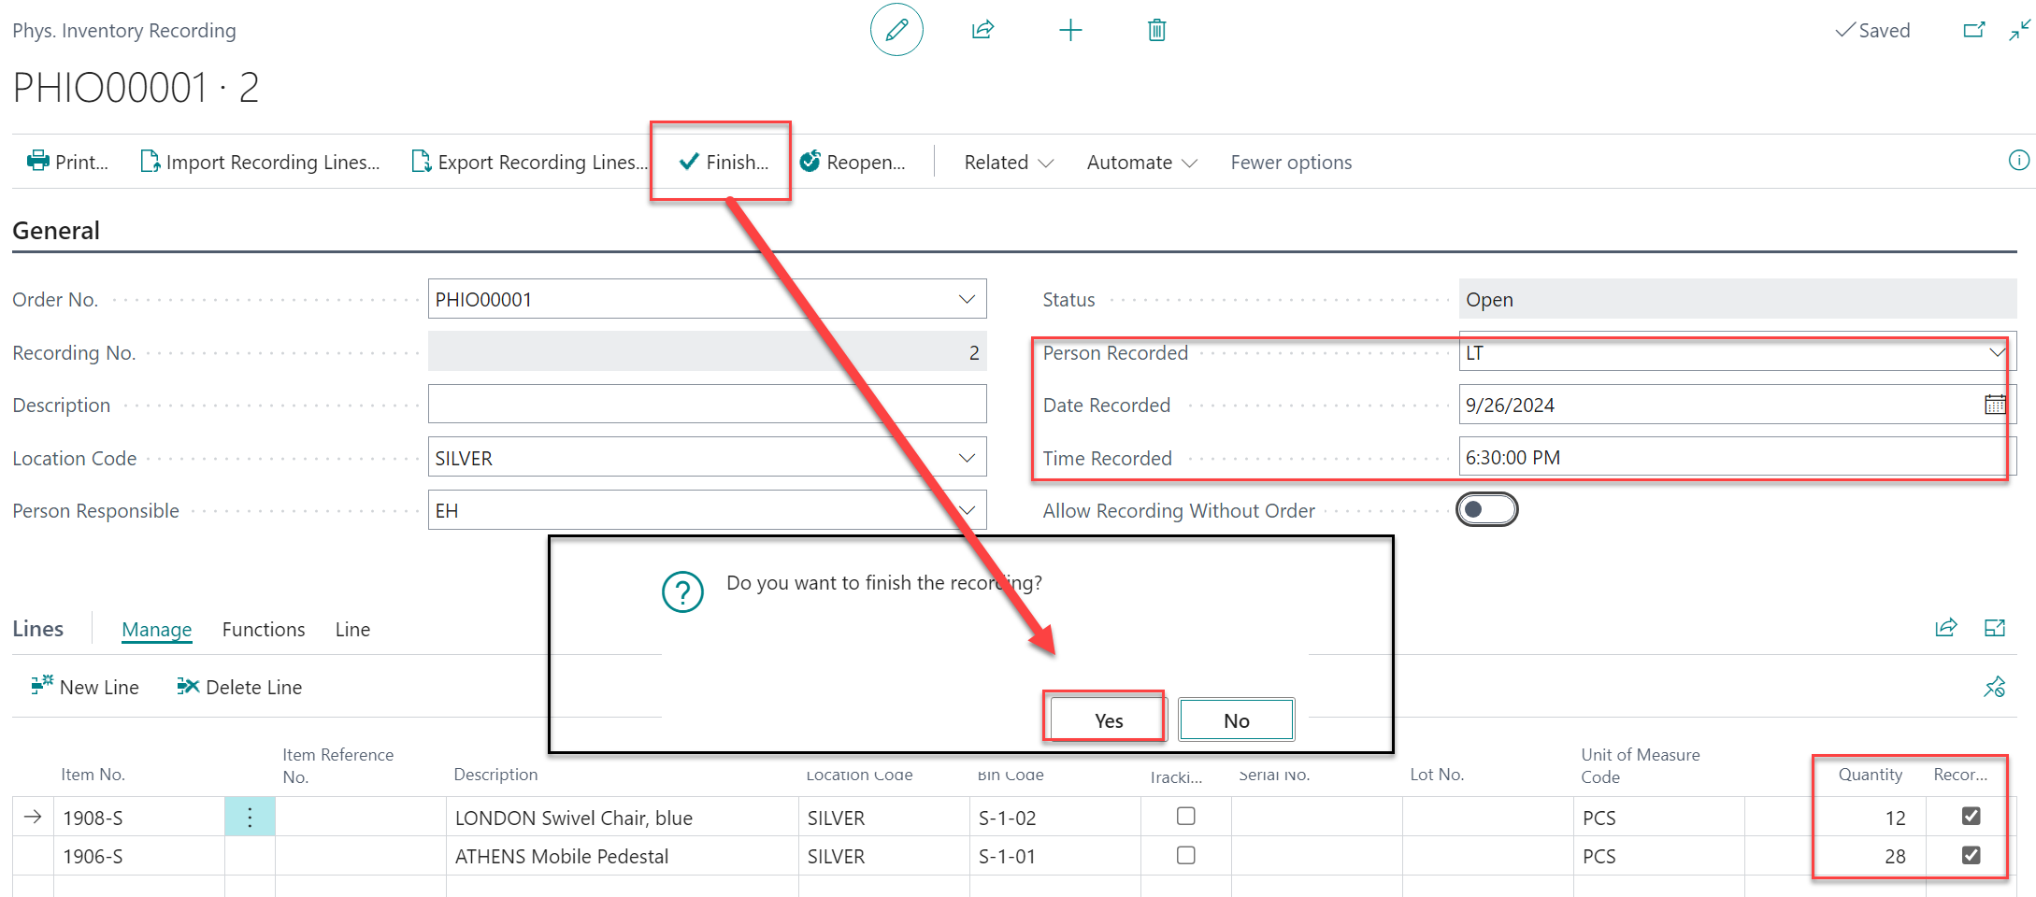
Creating a Physical Inventory Recording
  From the Physical Inventory Recording List, User enters results from Physical Inventory Recording Paper Document, entering Person Responsible, Date and Time.
  Then Select FINISH.
Notes:
Creating a Physical Inventory Order is a simple process. You can use the Physical Inventory Worksheet to create a physical inventory order. We will go over the steps to create a Physical Inventory Order.

Slide 57
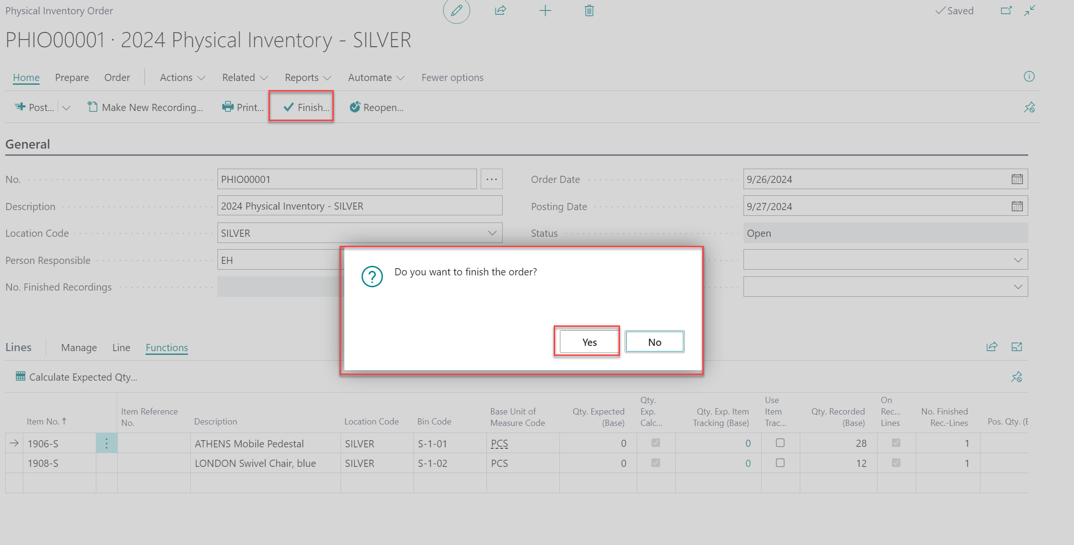
Creating a Physical Inventory Order
  From the Physical Inventory Order, User reviews the Items updated from Recording.
  Then the User Select FINISH.
Notes:
Creating a Physical Inventory Order is a simple process. You can use the Physical Inventory Worksheet to create a physical inventory order. We will go over the steps to create a Physical Inventory Order.

Slide 58
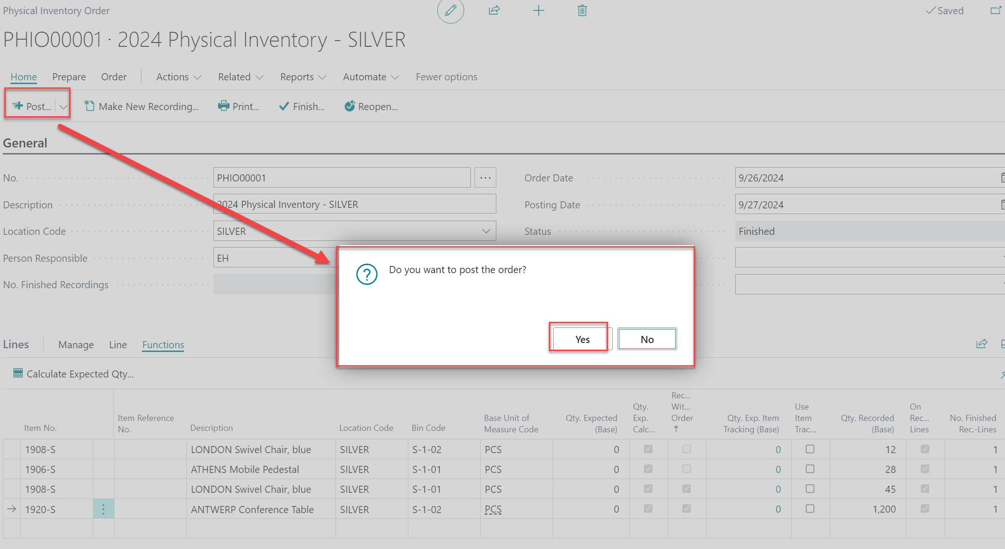
Creating a Physical Inventory Order
  From the Physical Inventory Order, User Selects Post, then Yes on Sub-Menu
Notes:
Creating a Physical Inventory Order is a simple process. You can use the Physical Inventory Worksheet to create a physical inventory order. We will go over the steps to create a Physical Inventory Order.

Slide 59
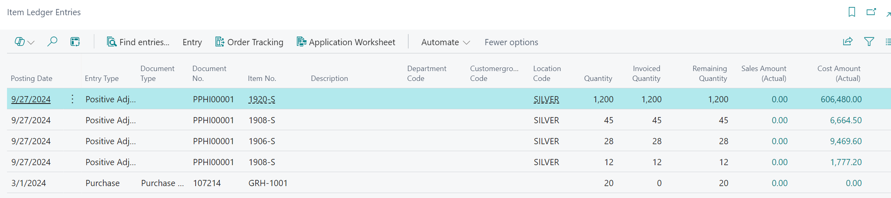
Reviewing a Physical Inventory Order thru Item Ledger Entries
Notes:
Creating a Physical Inventory Order is a simple process. You can use the Physical Inventory Worksheet to create a physical inventory order. We will go over the steps to create a Physical Inventory Order.

Slide 60

Physical Inventory Order & Recording - Conclusion
  Physical Inventory Order and Physical Inventory Recording are essential processes in Business Central that help you keep track of your inventory and avoid running out of stock. We hope that this presentation has been helpful in understanding the basics of these processes.
Notes:
Physical Inventory Order and Physical Inventory Recording are important processes in Business Central. By keeping track of your inventory, you can make sure you have enough stock on hand and avoid running out of inventory. We hope that this presentation has been helpful in understanding the basics of Physical Inventory Order and Physical Inventory Recording.

Slide 61
Business Central's New Inventory Cost Adjustment Feature
LP4 - Inventory Cost Adjustment Process
Notes:
In this presentation, we will explore Business Central's new inventory cost adjustment feature and how it can streamline your inventory management.

Slide 62

Traditional Inventory Cost Adjustment
Cumbersome Process
  Inventory cost adjustments are a cumbersome and time-consuming process that require extensive manual work, data entry, and reconciliation.
Prone to Errors
  Traditional inventory cost adjustment processes can be complicated and prone to errors, especially when the inventory is purchased at different prices or from different vendors.
Notes:
Traditionally, inventory cost adjustments have been a cumbersome and time-consuming process. They require extensive manual work, data entry, and reconciliation. Inventory cost adjustments involve updating the cost of inventory items to reflect the actual cost of acquiring them. This process can be complicated and prone to errors, especially when the inventory is purchased at different prices or from different vendors.

Slide 63

LP4 - Inventory Cost Adjustment Process
Inventory Cost Adjustment
  Inventory cost adjustment is a complex process that involves identifying the items that require cost adjustment, determining the correct cost and updating the inventory value.
Challenges in Traditional Cost Adjustment Process
  Traditional inventory cost adjustment process can be complicated and time-consuming, especially when dealing with large inventories. It can also lead to errors and discrepancies that can affect the accuracy of inventory valuation.
Notes:
The traditional inventory cost adjustment process typically involves identifying the items that require cost adjustment, determining the correct cost, and updating the inventory value. This process can be complicated and time-consuming, especially when dealing with large inventories.

Slide 64

New Inventory Cost Adjustment Feature
Individual Inventory Level Adjustment
  The new inventory cost adjustment feature allows you to adjust the cost of an item at an individual level, enabling you to update the cost of a specific item or group of items.
Automatic Cost Adjustment
  The feature provides automatic cost adjustments based on predefined rules, such as FIFO or LIFO. This saves time and reduces the risk of errors.
Notes:
Business Central's new inventory cost adjustment feature simplifies the process of adjusting inventory costs. This feature allows you to adjust the cost of an item at an individual level, making it easy to update the cost of a specific item or group of items. Additionally, the feature provides automatic cost adjustments based on predefined rules, such as FIFO or LIFO. This saves time and reduces the risk of errors.

Slide 65

Individual Item Cost Adjustment
Individual Item Cost Adjustment
  The new feature allows you to adjust the cost of an item at an individual level, making it easy to update the cost of a specific item or group of items. This can save time and reduce errors when updating inventory cost.
Detailed Audit Trail
  The feature provides a detailed audit trail, allowing you to track the changes made to the inventory cost. This can help you to maintain accurate inventory records and better manage your business.
Notes:
With the new feature, you can adjust the cost of an item at an individual level. This makes it easy to update the cost of a specific item or group of items. The feature also provides a detailed audit trail, allowing you to track the changes made to the inventory cost.

Slide 66

Automatic Cost Adjustments
Automatic Cost Adjustments
  The new feature provides automatic cost adjustments based on predefined rules, reducing the risk of errors and maintaining accuracy.
FIFO Method
  The system can be set up to automatically adjust the cost of items based on the FIFO method, which means that the items that were purchased first will be the first ones to be sold or used.
LIFO Method
  The system can also be set up to automatically adjust the cost of items based on the LIFO method, which means that the items that were purchased last will be the first ones to be sold or used.
Notes:
In addition to individual item cost adjustment, the new feature provides automatic cost adjustments based on predefined rules. This can help maintain accuracy and reduce the risk of errors. For example, you can set up the system to automatically adjust the cost of items based on the FIFO or LIFO method.

Slide 67
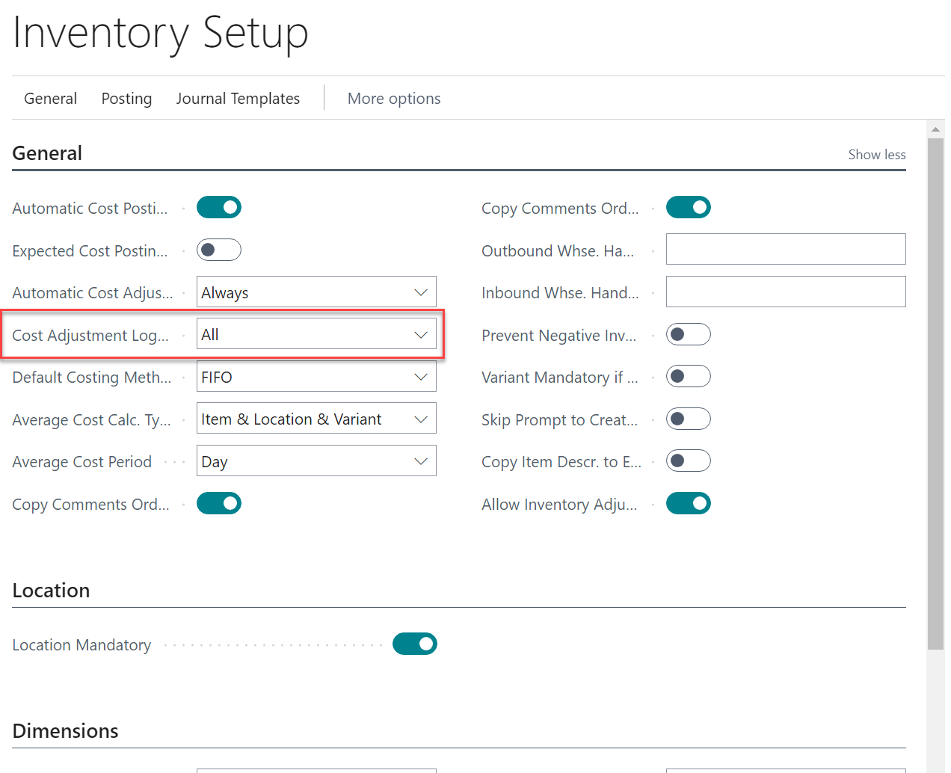
Setup new Feature
Inventory Cost Adjustment
Inventory Setup

Slide 68
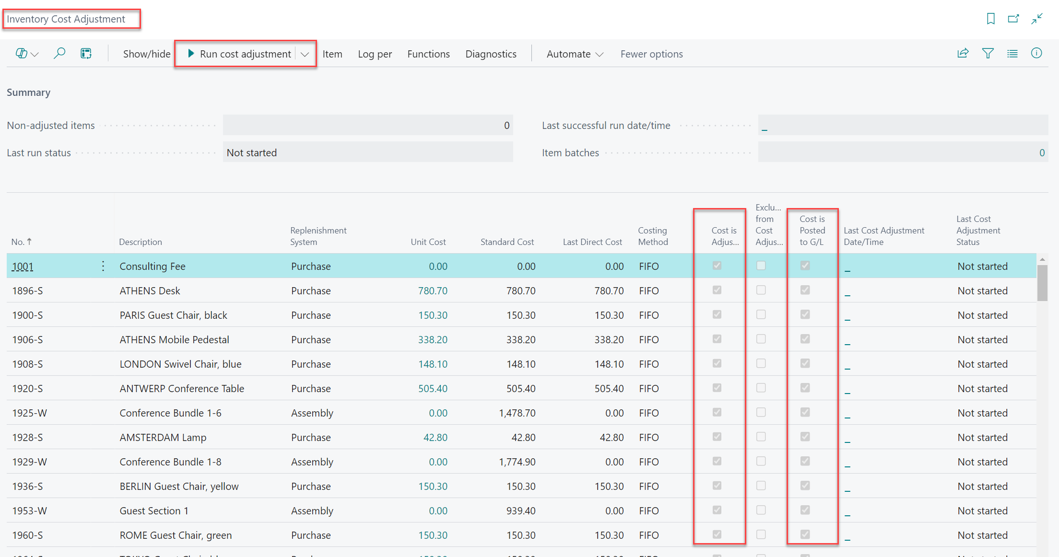
Inventory Cost Adjustment new Page

Slide 69
Demo – Inventory Cost Adjustment

Slide 70
Key take-aways
Key Take Aways
KTA1 – Item Type: Inventory, Non-Inventory, Service Items
KTA2 – Item Costing Method: FIFO, Standard, LIFO, Average, Specific, Default
KTA3 - Location Setup
KTA4 - Warehouse Management System – Basic, Advanced
KTA5 - Location Configuration – Bin Mandatory, Warehouse fast tab
KTA6 - Location and Bin Setup – Bin Type, Bin Content
KTA7 - Physical Inventory Journal
KTA8 – Physical Warehouse Inventory Journal & Item Journal
KTA9 – How to Decouple Warehouse Inventory (Location) from Inventory
Journal Item and General Ledger Entries (Finance)
KTA10 – Physical Inventory Order & Recording
KTA11 – Inventory Cost Adjustment new Page.

Slide 71

Thank you!

