Slide 1


Manage Finances in Business Central
Aleiha Hanson
3/10/2025

Slide 2


Speakers Wanted

Slide 3





2025 Webinar Committee:
Blaine Pennypacker
Webinar Program
Lewis Rosenberg
Programming Chair
Amanda Mayer
Webinar Program
Shawn Dorward
Programming Chair

Slide 4
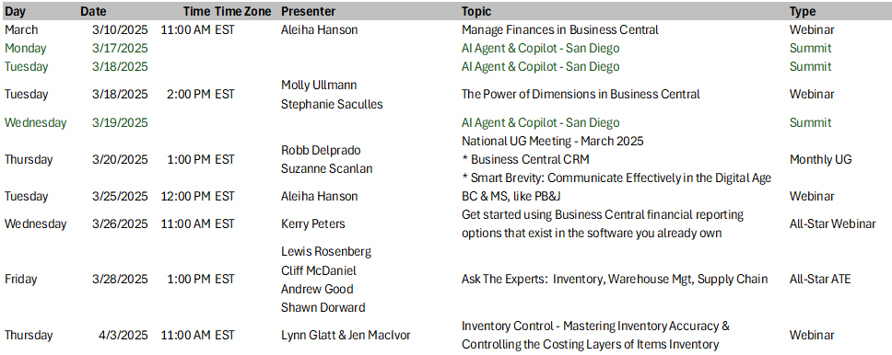
Event Calendar:
Dynamics Communities Events Calendar: https://dynamicscommunities.com/events/month/

Slide 5

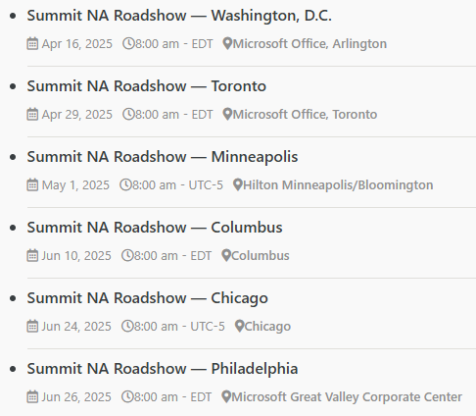
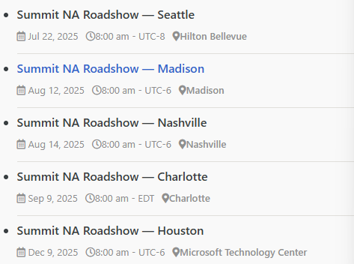
Summit RoadShow
https://dynamicscommunities.com/summit-roadshow/
https://DynamicsCommunities.com
> Events > Summit Roadshow

Slide 6


2023 SPONSOR KIT
You’re invited to the largest independent gathering of the Microsoft Business Applications ecosystem!
www.summitna.com
Notes:
Total Reg 4100 +15%, 1200BC Users (64% attendees), 8 BC Academy Classes
150+ Sessions, 131 Speakers incl MVPs and MS Product Managers

Slide 7
..and now
The Main Event!

Slide 8

Manage Finances in Business Central

Slide 9

Speaker:
Aleiha Hanson
Sr ERP Consultant, Heartland Business Systems
10+ years ERP end user/admin
3+ years consulting in GP & Business Central
Long time Dynamic Communities participant
GPUG All Star, Richard Whaley recipient, planning committee, presenter & writer

Slide 10
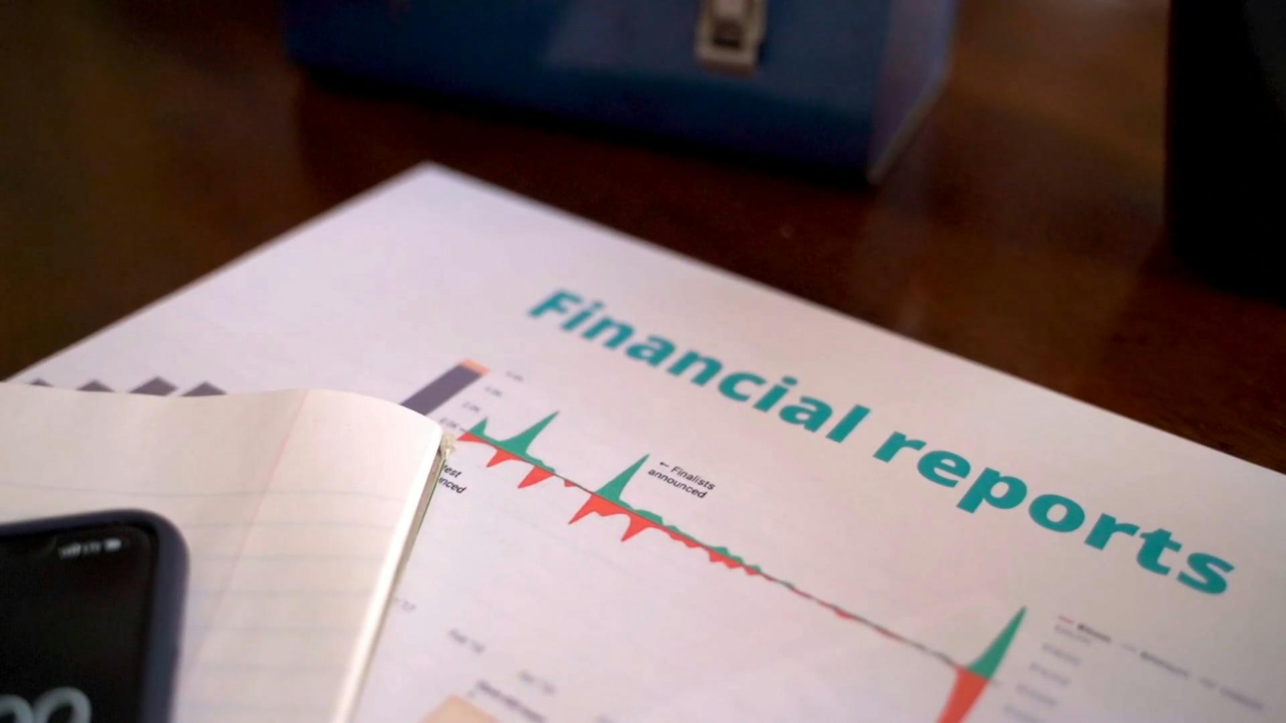
Agenda:
        Out-of-the-Box Financial Reporting
        Reports vs. Analysis Views
        Building Reports
        Tips & Tricks

Slide 11
Financial Reports vs. Analysis Views
Balance Sheet
Income Statement
Cash Flow
Retained Earnings
Great for internal & external
Trial balance
Dimension analysis
Great for internal

Slide 12
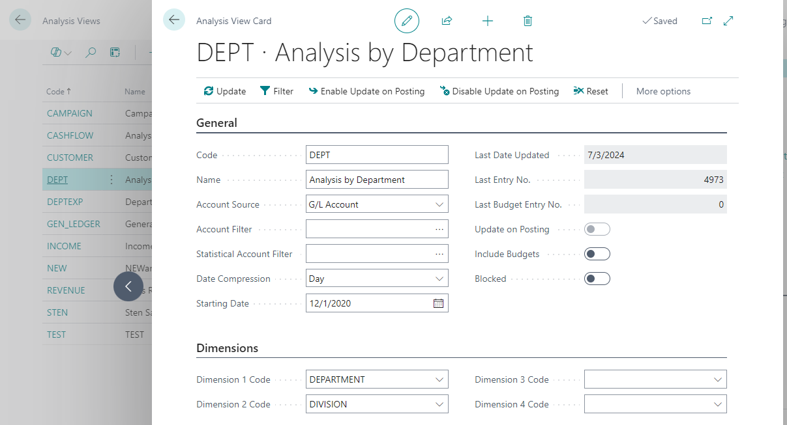
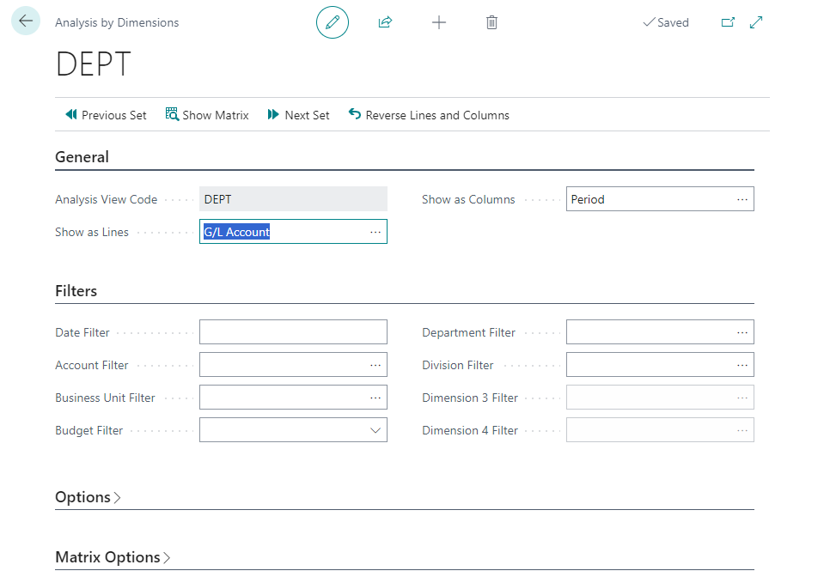
Building Views
Create a view
Add/edit filters
Show Matrix
Tip: Be sure to “update”

Slide 13
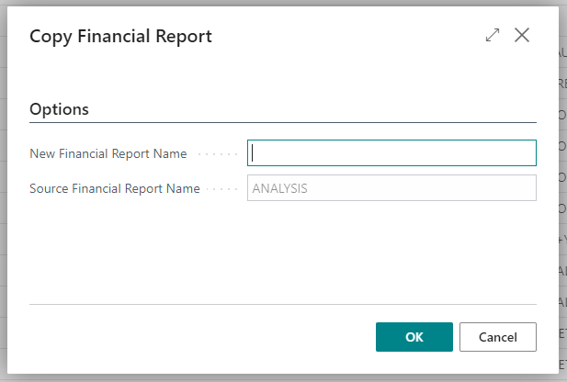
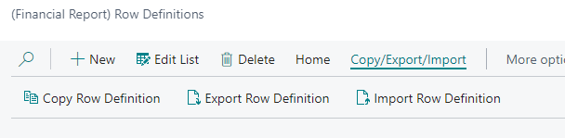
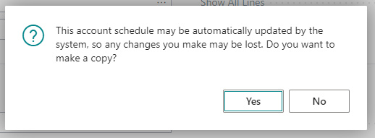
Copy Financial Reports
Full Reports
Rows
Columns

Slide 14
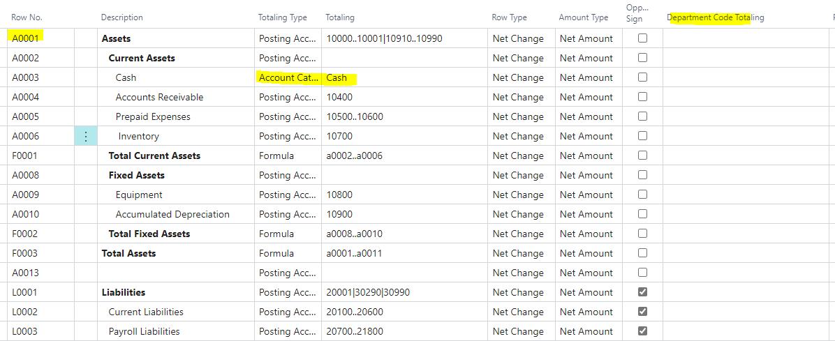
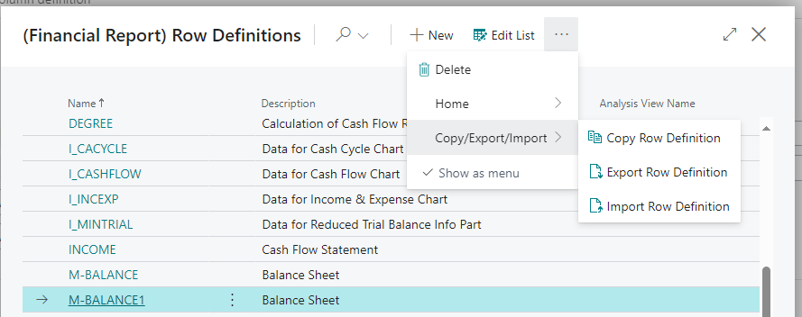

Modify & Build Rows
Tips:
Copy! Don’t reinvent the wheel
Use account categories
Name/number rows
Utilize dimensions
Consider formula dependencies

Slide 15
Modify & Build Columns
Tips:
Use the copy function
Specify the proper column type
Use the right comparison fields
Pull in dimensions

Slide 16
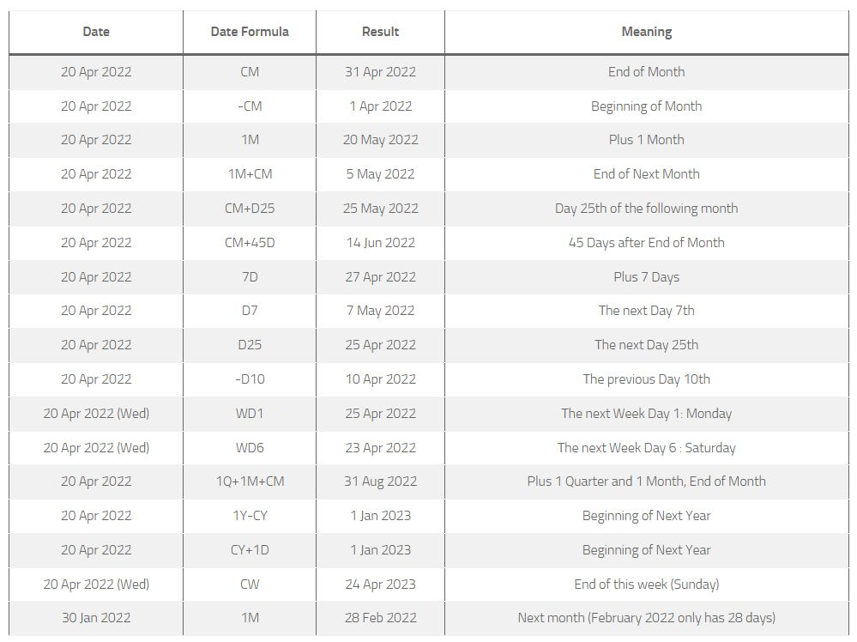
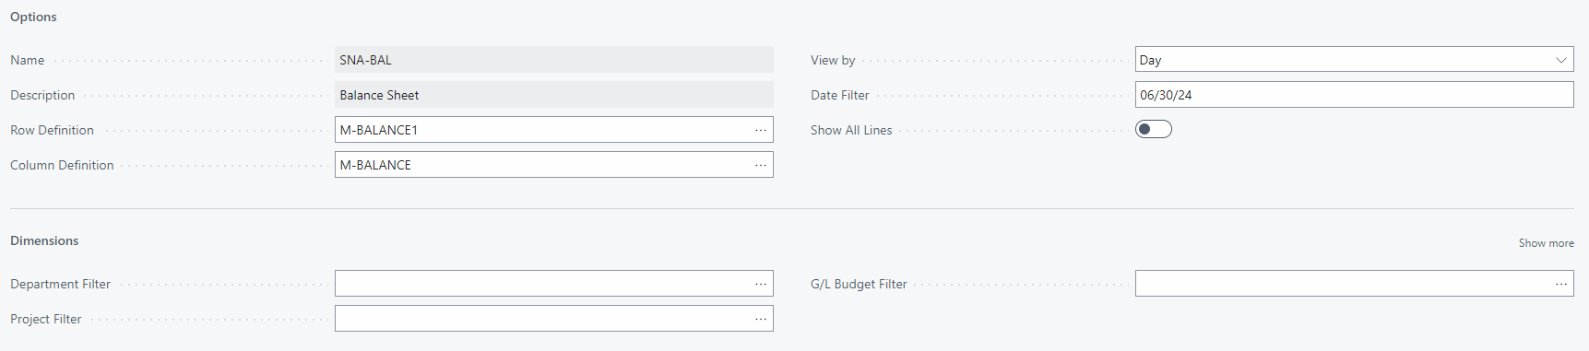
Filtering
Tips:
Use dimensions for filtering reports, not just defining
Use date shortcuts (see resource list)

Slide 17
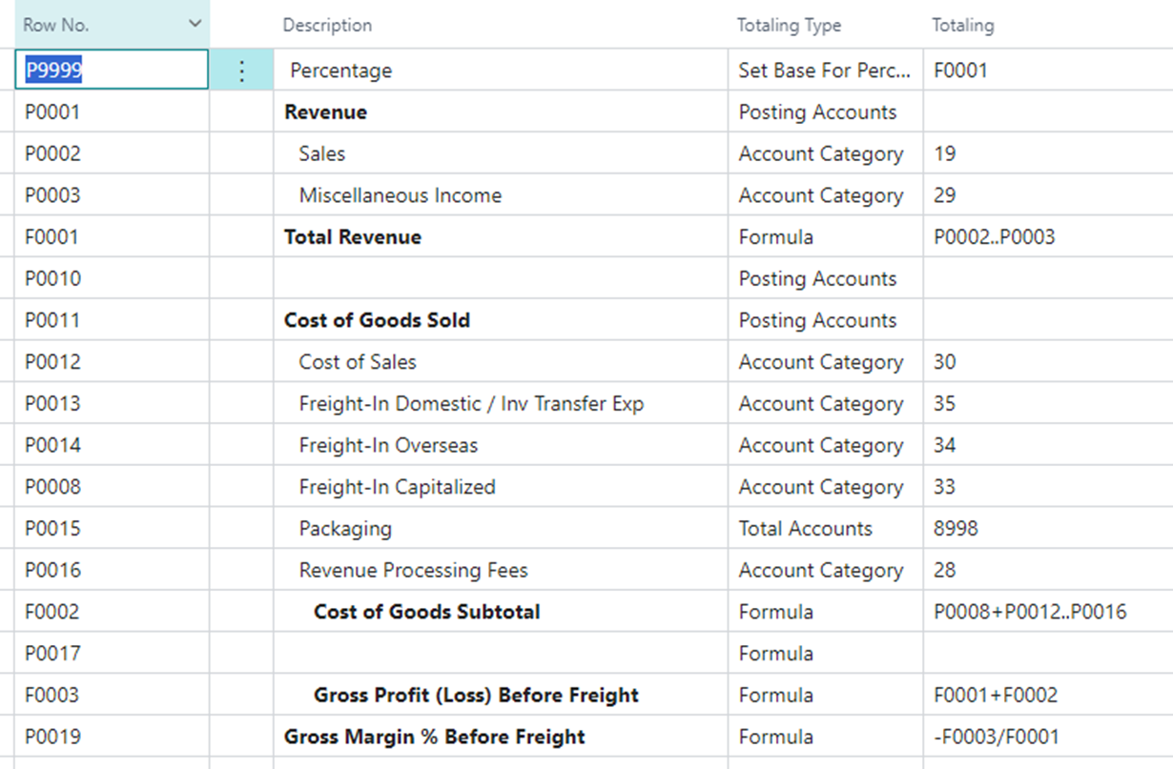
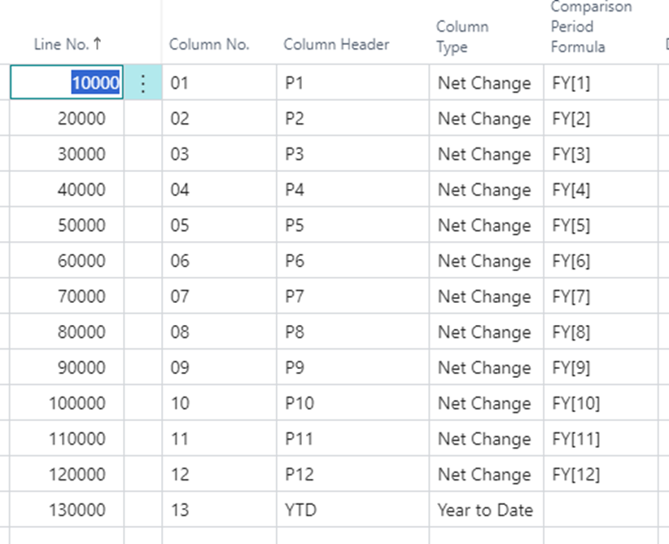
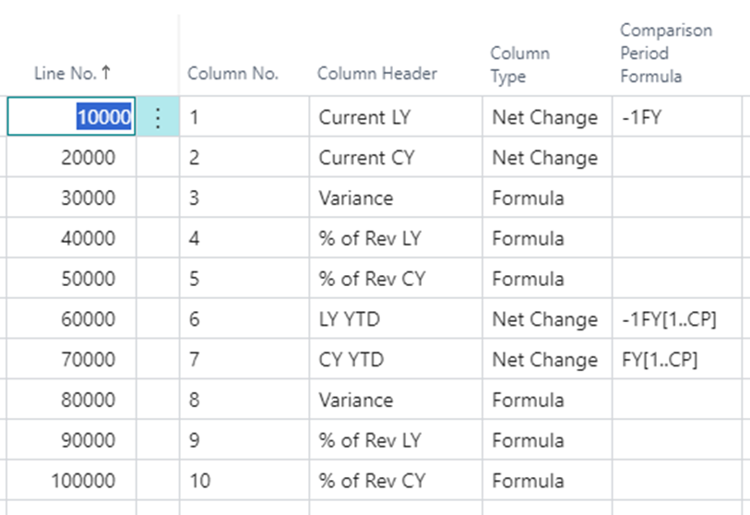
Row & Column Examples

Slide 18
Resources
Blog — Kerry Peters, Microsoft MVP
Date Formulas - That NAV Guy
Build Financial Reports - MS Learn
Bing Videos
Additional Options
Power BI
Excel
Third party reporting solutions

Slide 19
Demo!

Slide 20

Thank you!

