Slide 1


BC & MS, like PB&J
Aleiha Hanson
3/25/2025

Slide 2


Speakers Wanted

Slide 3
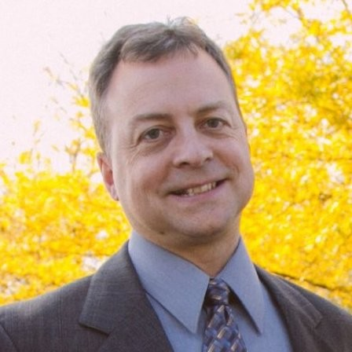
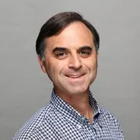
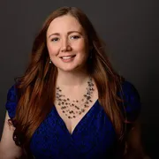
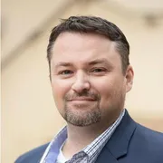

2025 Webinar Committee:
Blaine Pennypacker
Webinar Program
Lewis Rosenberg
Programming Chair
Amanda Mayer
Webinar Program
Shawn Dorward
Programming Chair

Slide 4
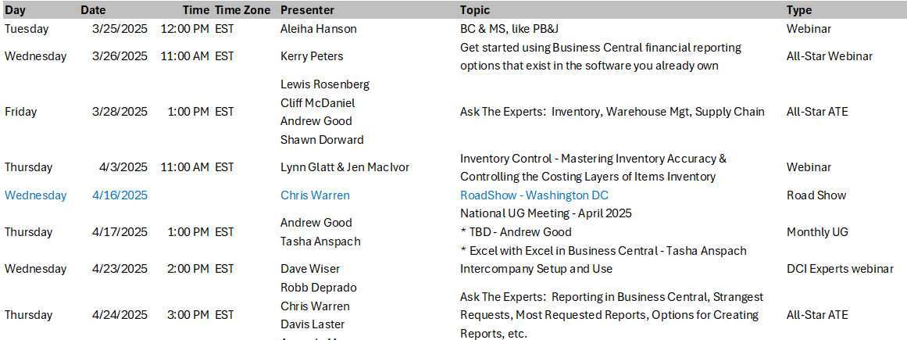
Event Calendar:
Dynamics Communities Events Calendar: https://dynamicscommunities.com/events/month/

Slide 5

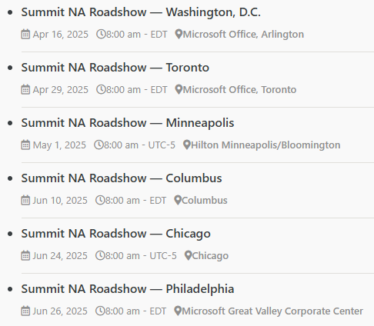
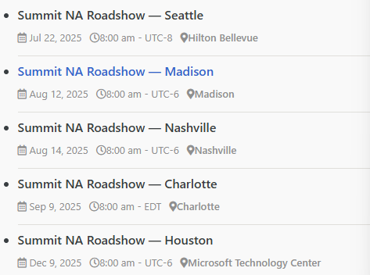
Summit RoadShow
https://dynamicscommunities.com/summit-roadshow/
https://DynamicsCommunities.com
> Events > Summit Roadshow

Slide 6


2023 SPONSOR KIT
You’re invited to the largest independent gathering of the Microsoft Business Applications ecosystem!
www.summitna.com
Notes:
Total Reg 4100 +15%, 1200BC Users (64% attendees), 8 BC Academy Classes
150+ Sessions, 131 Speakers incl MVPs and MS Product Managers

Slide 7


BC & MS
Like PB & J

Slide 8

Speaker:
Aleiha Hanson
Sr ERP Consultant, Heartland Business Systems
10+ years ERP end user/admin
3+ years consulting in GP & Business Central
Long time Dynamic Communities participant
GPUG All Star, Richard Whaley recipient, planning committee, presenter & writer

Slide 9




Agenda:
        Business Central & Microsoft Stack
        Outlook
        Teams
        Excel
        Word
        Copilot
        …and more

Slide 10
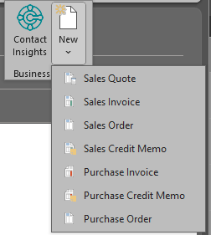
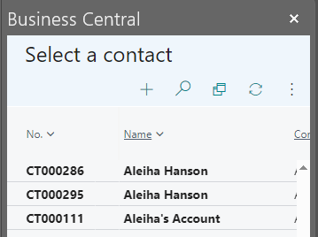
From Outlook
Create Documents
Manage Contacts

Slide 11
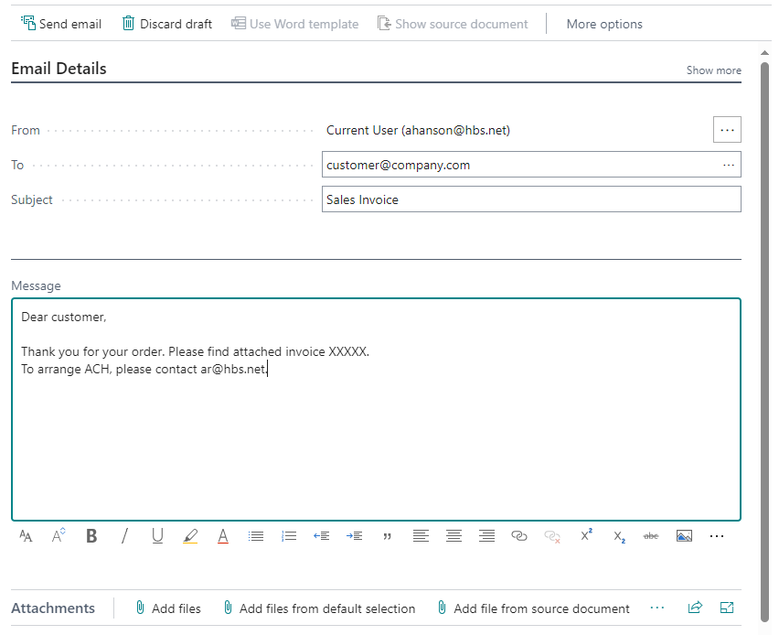
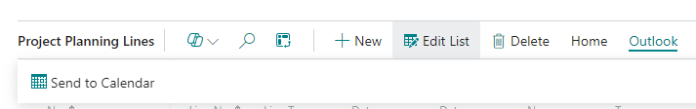
To Outlook
Send Communications
Add Appointments

Slide 12
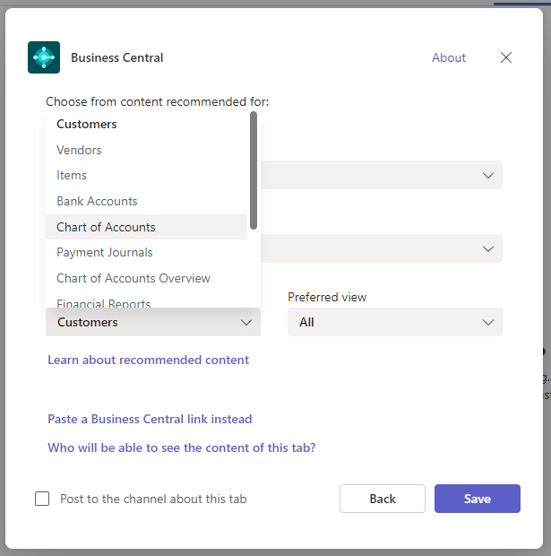
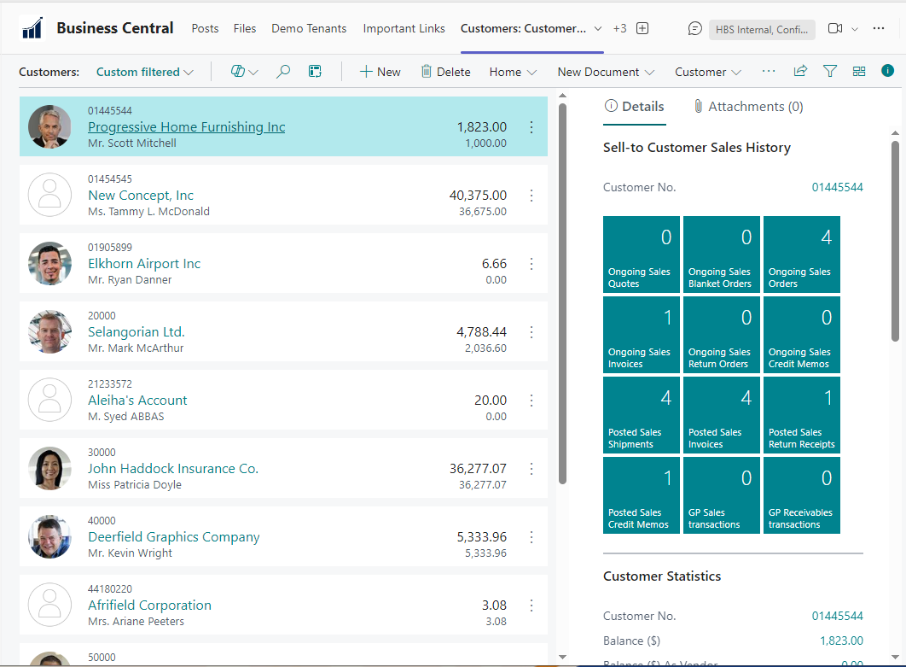
From Teams
Access Data Including
  Master Records
  Reports
  Journals
  Even 3rd Parties!

Slide 13
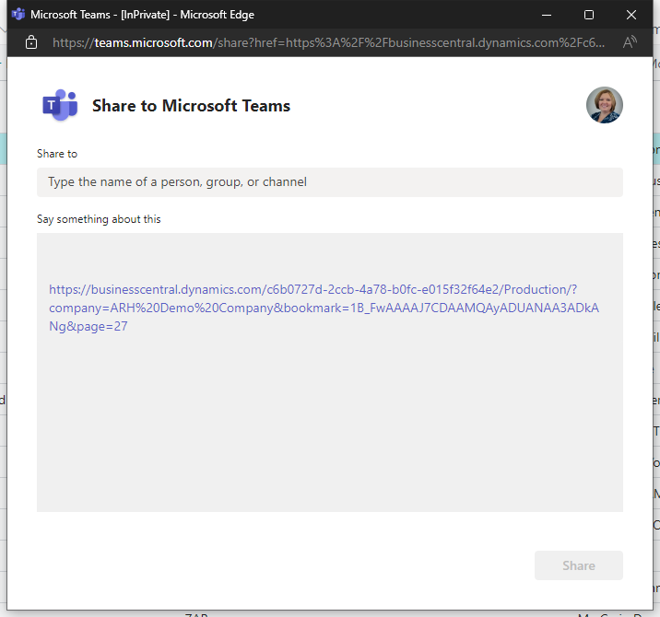
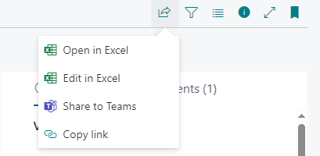
To Teams
Share Data Quickly!
Best part, NO BC license required!

Slide 14
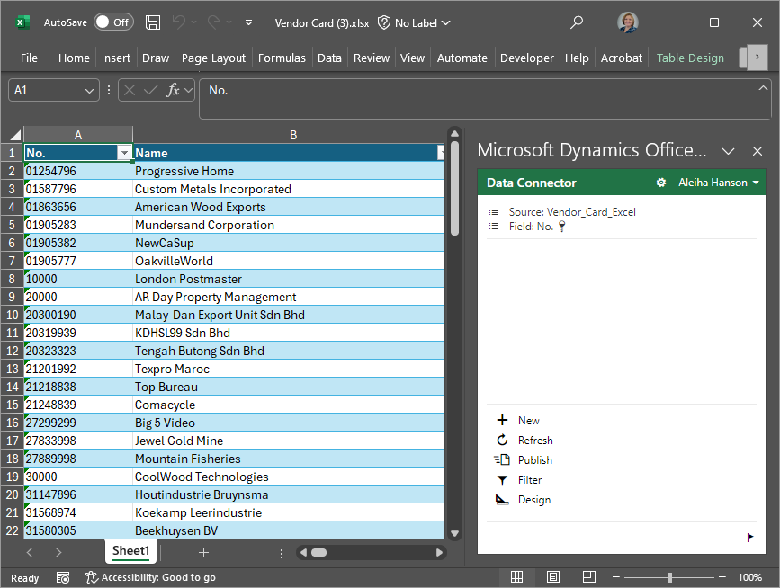
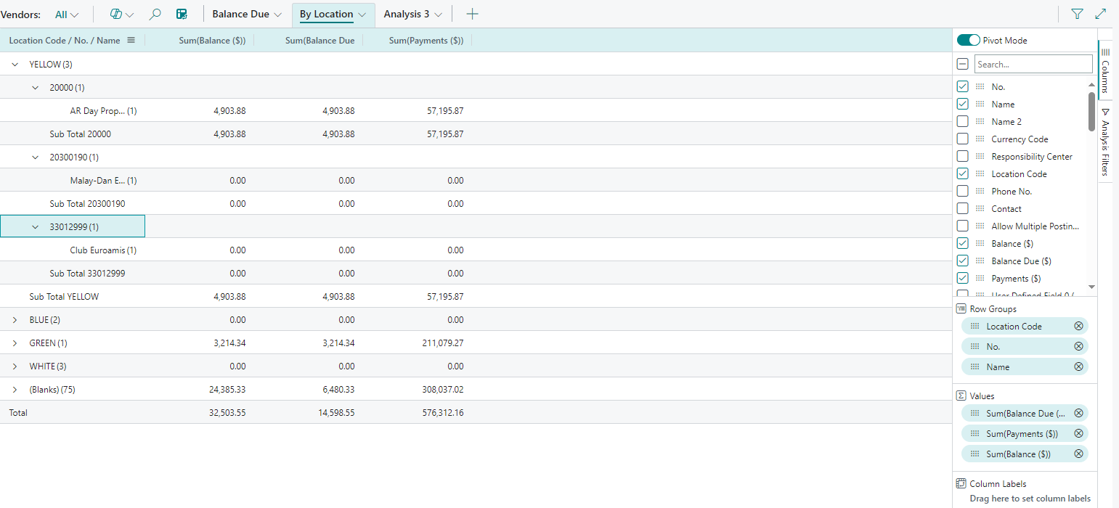
Excel Inside & Out
Analysis Mode
Open (Snapshot)
Edit (My fave!)

Slide 15
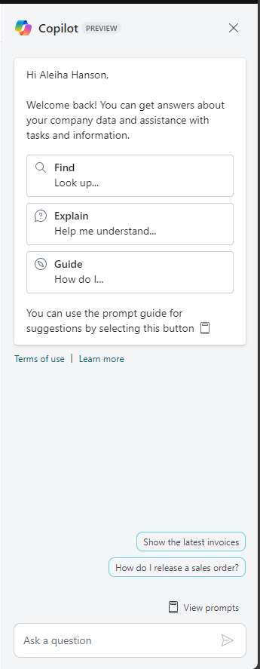
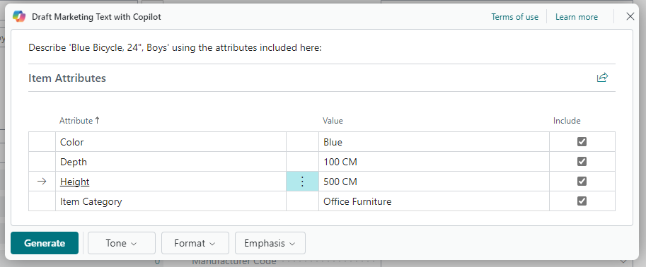
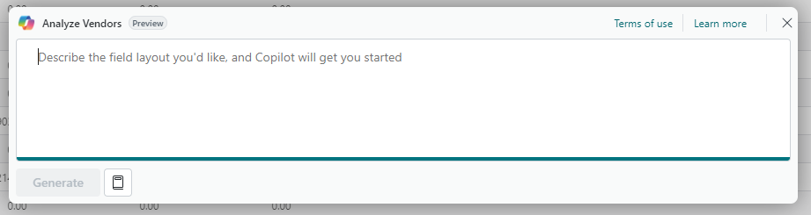
The cup of milk…Copilot
Create Analysis Views
Dig for Data
Marketing
Bank Rec

Slide 16
Other Integrations
Word (think report layouts)
Other Dynamic & Power Platform Products
  Sales Hub
  Marketing
  Field Service
  Power Automate
Many More!

Slide 17
Demo!

Slide 18

Thank you!

